Slide 1
Sustainable Financing for IAS Management in the Caribbean
A case for the Caribbean IAS Trust Fund

Slide 2
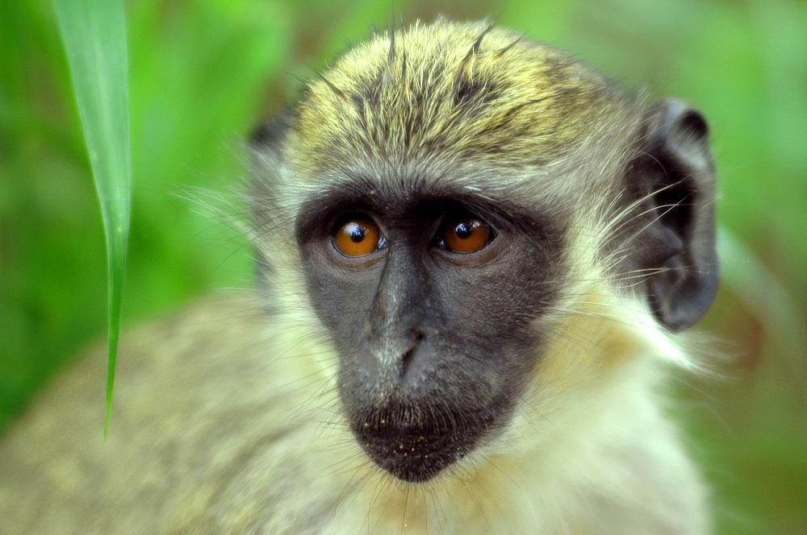
Financing Solutions
The Sustainable Trust Fund report proposed two solutions for financing IAS management in the Caribbean:
Trust Fund
Policy Options

Slide 3
Policy Options
Mandatory Insurance
Deposit/performance bonds
Fees or charges
Levies and taxes
Environmental Taxes and User Fees.

Slide 4
Case for a Trust Fund (TF)
A TF will independently mobilize, blend and oversee the collection and allocation of financial resources to facilitate its one overarching reason for existing:
strategic focus, rigorous [IAS] project management, solid monitoring and evaluation and high levels of transparency and accountability
Regional infrastructure is in place for successful TF execution:
The existence and success of the Caribbean Biodiversity Fund (CBF)
The presence of Latin American and Caribbean Network of Environmental Funds (RedLAC) which supports TF in adopting Practice Standards defined by the Conservation Finance Alliance (CFA)

Slide 5
Case for a Trust Fund
No TF currently in the Caribbean has regional focus and Caribbean IAS management as one of its key objectives
TFs under RedLAC are primarily focused on Latin American countries with their own significant biodiversity challenges
IAS management among proximate islands is separate and distinct from IAS management on continents.

Slide 6
Overview of Operational Framework
As part of this consultancy, an Operational Framework has been developed which outlines the structure and functionality of the proposed CIAS TF
The following sections provide brief discussion on the proposed framework
This remains a working document and will be amended accordingly based on the feedback received today

Slide 7
Contents of Operational Framework
Core Principles
Legal Structure
Board
Administration
Operating Procedures
Communication Strategy
Financial Management – Resource Mobilisation
Financial Management – Asset Management

Slide 8
Core Principles
Vision
To lead the region in developing cohesive, consistent and effective IAS management strategies, actions and policies.
Mission
To secure and mobilise financing to proactively support Caribbean countries to mitigate the threats to biodiversity from both new and existing IAS.
Scope of Work
The purpose of the CIAS TF is to mobilise sustainable and consistent financing for IAS management activities throughout the Caribbean region to combat the environmental, social and economic threat of IAS.

Slide 9
Legal Structure
The CIAS TF will be established as a trust fund with the purpose of IAS management throughout the Caribbean
The Board of the CIAS TF will serve as trustee of the fund, managing assets comprising the monies generated by the fund and other assets which support its operation
The recommended location for legal establishment is in Barbados based on the supporting legal environment for Trust Funds as well as its established financial services industry
Investment management takes place elsewhere, admin in Bdos

Slide 10
Legal Structure
To be established as a Trust under Barbados law, the following legislation is applicable:
Trusts (Miscellaneous Provisions) Act, 2018
Charities Act, 1980
Trustee Act

Slide 11
Case for Barbados
Specific Trustee Act defining responsibilities of the trustee
Charities Act with explicit guidelines regarding tax exemptions for charities
No limit on number of trustees or nationality requirements
Strong financial services industry with experienced professionals to support fund establishment

Slide 12
CIAS TF Relationship Chart
Donors
Contributions
Country Governments
Board
Key
Administration
Funds Flow
Technical Support
Grant Making Process
Information Flow
Beneficiaries

Slide 13
Board
The board of directors of the CIAS TF will be composed of diverse, multi-stakeholder members
This may include country government representatives, NGOs, private individuals and CBF or CABI representatives
The Board will provide support in the following areas
Legal and Governance
Financial;
Representation;
Fund raising; and
Administration

Slide 14
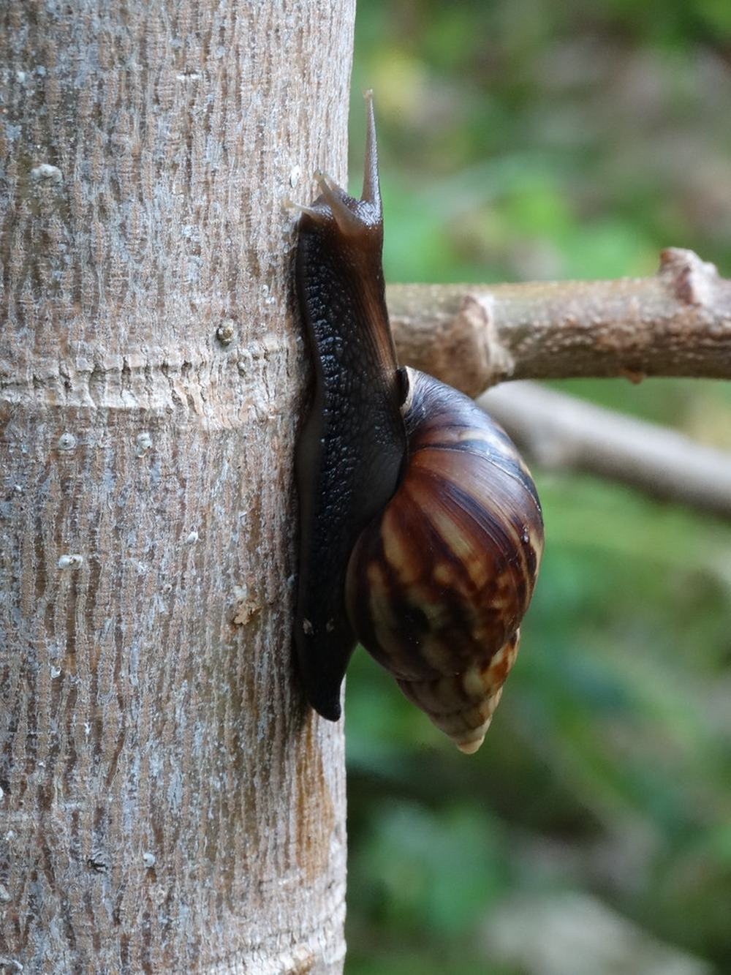
Board
The board may also establish committees to channel advisory expertise in specific focal areas, including
Finance/Investment
Technical
Fundraising

Slide 15
Administration
Management of the CIAS TF will be the joint responsibility of the Board and administrative staff, led by the Chief Executive Officer who will act as a focal point between both parties
The Chief Executive Officer will be hired based on a rigorous recruitment process supported by a terms of reference outlined and approved by the Board

Slide 16
Administration
Monitoring and Reporting
The CIAS TF administration will develop reports which evaluate the Fund’s performance and impact in achieving its mission
Annual Report – Review of activities for the year including grants provided and projects overseen. Financial report on investment performance included as well.
Audited Financial Statements – Audited review of Fund accounts in accordance with international accounting standards. Added to the Annual Report.

Slide 17
Operating Procedures – Grant Making
Grants will be the primary means through which funds are distributed to beneficiaries to engage in IAS management activities and projects
The grant-making process is based on the thematic areas of the CIASTF, proposed as:
Prevention of new IAS
Detection and eradication of recently introduced IAS
Management of widespread IAS

Slide 18
Operating Procedures – Grant Making
Types of Grants Offered
Education and Awareness
Capacity Building/Technical Support
Prevention, early detection, eradication & management of IAS
Policy and Legislative Development
Research
Grant Sizes (Proposed)
Micro – Less than USD 10,000
Small – USD 10,000 – USD 20,000
Medium – USD 20,0000 – USD 40,000
Large – USD 40,000 and above

Slide 19
Grant Making Process
Call for Proposals
Full Proposal Form
Approval
Execution
Submission of Concept Note
Screening and Evaluation
Grant Strategy published by CIAS TF to notify of opening for applicants and eligibility requirements
Submission of concept notes by applicants
Approved concept notes followed by Grant Proposal Forms containing full detail of the proposed project
Screening and Evaluation to select grantees
Approval of grant by Board and/or CEO
Execution of project and periodic submission of reporting requirements

Slide 20
Operating Procedures – Grant Making
Reporting Requirements
Project goals should be SMART (Specific, Measurable, Attainable, Relevant, and Timely)
Monitoring should be cost-effective for grantees and reproducible by different beneficiaries
Baseline data is required to track project impacts over time.
Financial reporting should meet suitable international accounting standards
Monitoring may take the form of interviews with grantees and stakeholders and site visits, in addition to technical and financial reports
Lessons learnt at the end of project implementation should be recorded for CIAS TF and partners to refine future activities

Slide 21
Communication Strategy
The Communication Strategy will guide the type and contents of communications provided by the CIAS TF to various audiences and stakeholders. The strategy has the following aims:
To engage with stakeholders
To build awareness of the IAS problem in the Caribbean
To highlight the work of the CIAS TF
To develop a clear brand and messaging associated with the CIAS TF
To present the effective use of funds to potential and current donors

Slide 22
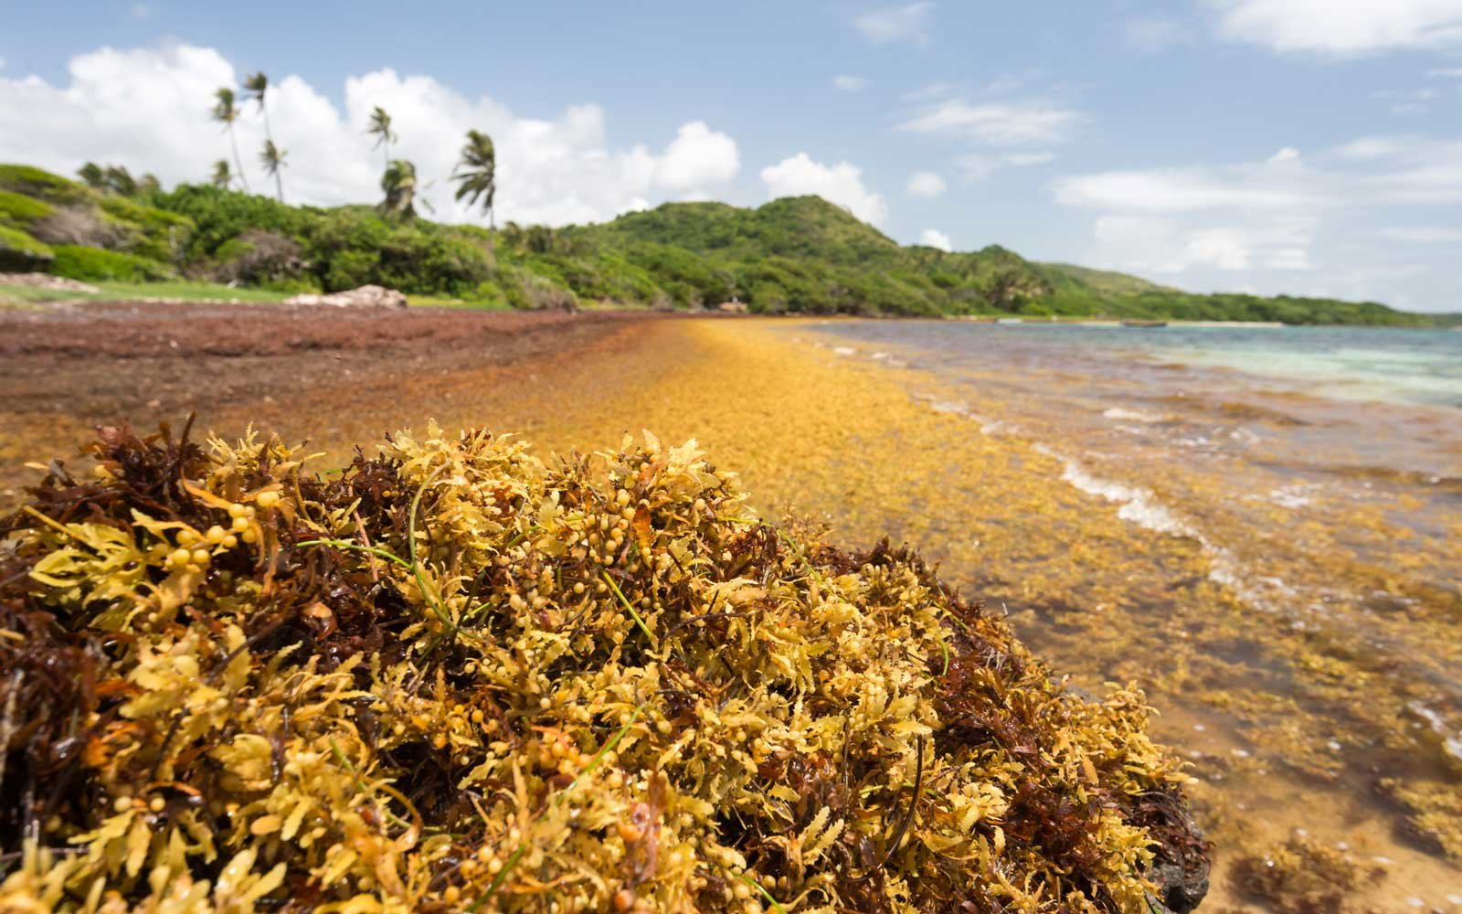
Communication Strategy
The target audience for communication include:
General Public
Government Stakeholders
Civil Society
Beneficiaries
Board of Directors
Donors

Slide 23
Communication Strategy
The strategy will be implemented using various tools, modelled off of the communication activities of existing Trust Funds. These are:
Annual Reports
Website
Social Media
Public Relations Materials
Press Releases
The CIAS TF will also develop a strong brand identity, including:
Logo
Thematic Colours
Fonts

Slide 24
Financial Management - Resource Mobilisation
To meet the financing requirements of the CIAS TF, multiple funding streams are required. These may be elaborated in a Fundraising Plan that identifies suitable donors and viable mechanisms to generate funds. The Fundraising Plan should be developed by the administration and may contain:
Determine the financial requirements for operation and minimum capital requirements
Identify eligible donors and sponsors for the CIAS TF
Understanding donor requirements and CIAS TF eligibility
Preparation of funding proposals tailored to both donor requirements and priorities,
Policies for screening donors to ensure protection of the CIAS TF brand and image

Slide 25
Financial Management - Resource Mobilisation
Being established under the CBF umbrella enhances the CIAS TF exposure and reputation with donors in the conservation space
The CIAS TF will also benefit from capacity building activities by the CFA and REDLAC
Country government support through financing and technical assistance will also be pivotal in early stage development of the CIAS TF
Use of policy options recommended earlier to generate funding is beneficial to generate continuous financial flows
The CBF also offers prefinancing to its Partner TFs with no co-financing requirement

Slide 26
Financial Management - Resource Mobilisation
The CIAS TF may also leverage its technical expertise and management capabilities to generate income through provision of services to external entities.
The CIAS TF may also pursue alternative financing mechanisms to generate funds. These will likely require broad based support from country governments whose interests and policy align strongly with CIAS TF activities. For example:
Debt for Nature Swaps
Biodiversity offsets
Bioprospecting fees

Slide 27
Financial Management - Asset Management
The investment strategy adopted by the CIAS TF will be critical to ensure that returns are sufficient to support operating expenses over the medium term.
Investment management services offered by the CBF can be used to pool funds with other TFs under management, thereby lowering risk and increasing potential earnings
The initial capital invested into the CIAS TF will be expected to support capacity building activities in Barbados and the OECS
Initial expenses for operation are estimated at USD $450,000 per annum

Slide 28
Financial Management - Asset Management
The CIASTF may use a variety of funds as part of the asset management strategy. These include
Endowment Fund – This will comprise the main asset, a fund which aims to generate returns of 3% plus inflation per year. It is recommended that this fund have a mix of asset distribution, with 50-60% equity, minimal cash, and fixed income in the 20-30% range.
Revolving Fund – This fund may be financed by policies in participating countries which generate income to be used for the sustainable management of IAS.
Sinking Fund - In the early phases of establishment, a sinking fund is highly recommended. The sinking fund provides short term liquidity while allowing the endowment to grow uninterrupted

Slide 29
Thank you for listening!
We now invite you to take a short poll where you may provide your feedback on the proposed CIAS TF and IAS management in the Caribbean

