Slide 1
Improving Biosecurity in Barbados and the OECS through Enhanced National Capacity to Conduct IAS Risk Assessments
Presented By:
Mrs Natisha Duncan-Joseph
Mr Columbus Philippe
Date: 13th June 2022

Slide 2
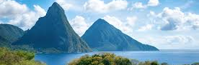
COUNTRY REPORT
ST LUCIA

Slide 3
ORGANISATION OF BIOSECURITY
The Ministry of Agriculture through the following divisions executes the functions of the island’s biosecurity.
Crop Protection and Quarantine
Veterinary & Livestock Services
Forestry Department (limited)
Fisheries Department (limited)

Slide 4
ORGANIZATIONAL OUTLOOK
There is an advanced initiative to merge key government agencies to form a single ‘border protection’ agency.
Customs
Immigration
Marine and Port Police
Plant Quarantine
Animal Quarantine
Port Health

Slide 5
IMPORTATION PROCESS
An application for an import permit to import any plant or plant related commodity or any live animal or product of animal origin and seafood products into Saint Lucia has to be completed and submitted by the customer.

Slide 6
IMPORTATION continued
Application for commodities which are regularly imported and of low risk has a shorter time for approval to be granted.
Commodities of higher risk has longer approval time since pest risk analysis has to be conducted to determine the outcome of the application.

Slide 7
IMPORTATION continued
CABI Compendium is used as a guide to determine import requirement for new product or products that has not been imported for a long time
It is also used to verify invasiveness of plant specie import request
Distribution of pests of plants on the CABI website is also used to help determine the decision to import

Slide 8
Imports
Pest Risk Analysis exist for pests and diseases of plants, animals, and their products.

Slide 9
ST. LUCIA PORTS OF ENTRY
G. F. L. Charles Airport
Hewanora International Airport
Castries Seaport
Vieux-Fort Seaport
Rodney Bay Marina
Marigot Bay
Soufriere Bay

Slide 10
PORTS OF ENTRY continued
With the increase in online shopping, courier service establishments have become a point of entry of regulated goods. Notwithstanding, import regulations must be applied.

Slide 11
Animal regulated diseases of
Bovine Spongiform Encephalopathy (BSE)
Rabies
Avian Influenza (AI)
Foot and Mouth Disease (FMD)
Newcastle
Hog Cholera
African Swine Fever (ASF)

Slide 12
Plant regulated pest
Fusarium wilt (TR4)
Lethal yellowing
Red palm weevil
Citrus canker
Moko disease
Tuta absoluta
Mexican fruit fly

Slide 13
EXPORTATION
Persons who wish to export any plants, plant related commodities or animals, animal products and sea food from St. Lucia to any country has to meet the import requirements of that country.
Commodities that are prohibited entry into any country is denied export.

Slide 14
EXPORTATION continued
Documents required for export includes some of the following:
Import permit
Phytosanitary certificate
Treatment certificate
Health certificate
Certificate of wholesomeness
CITES certificate for items which are endangered

Slide 15
INSPECTION
For casual imports, the customs department is our first line of defence. Any item that is of plant or animal origin is detained and an officer from the Plant Quarantine or Veterinary and Livestock Unit is informed.

Slide 16
INSPECTION continued
Document for detained item is obtained if available and reviewed.
Item is examined and if it meets the necessary conditions for import it is released for entry. If conditions are not what is regulated the item is confiscated for disposal.

Slide 17
INSPECTION continued
For commercial imports, there is an established inspectorate which conducts inspections on imported meats, meat products, fruits, vegetables containerized and break bulk. These inspections are either at the ports or at the business premises.

Slide 18
SURVEILLANCE AND MONITORING
There is an ongoing surveillance for fruit flies, tuta absoluta monitoring
Active surveillance and monitoring for the amblyomma variegatum tick, and varora mite in bees.
Receive bulletins, updates and alerts from international, regional organizations on outbreaks.

Slide 19
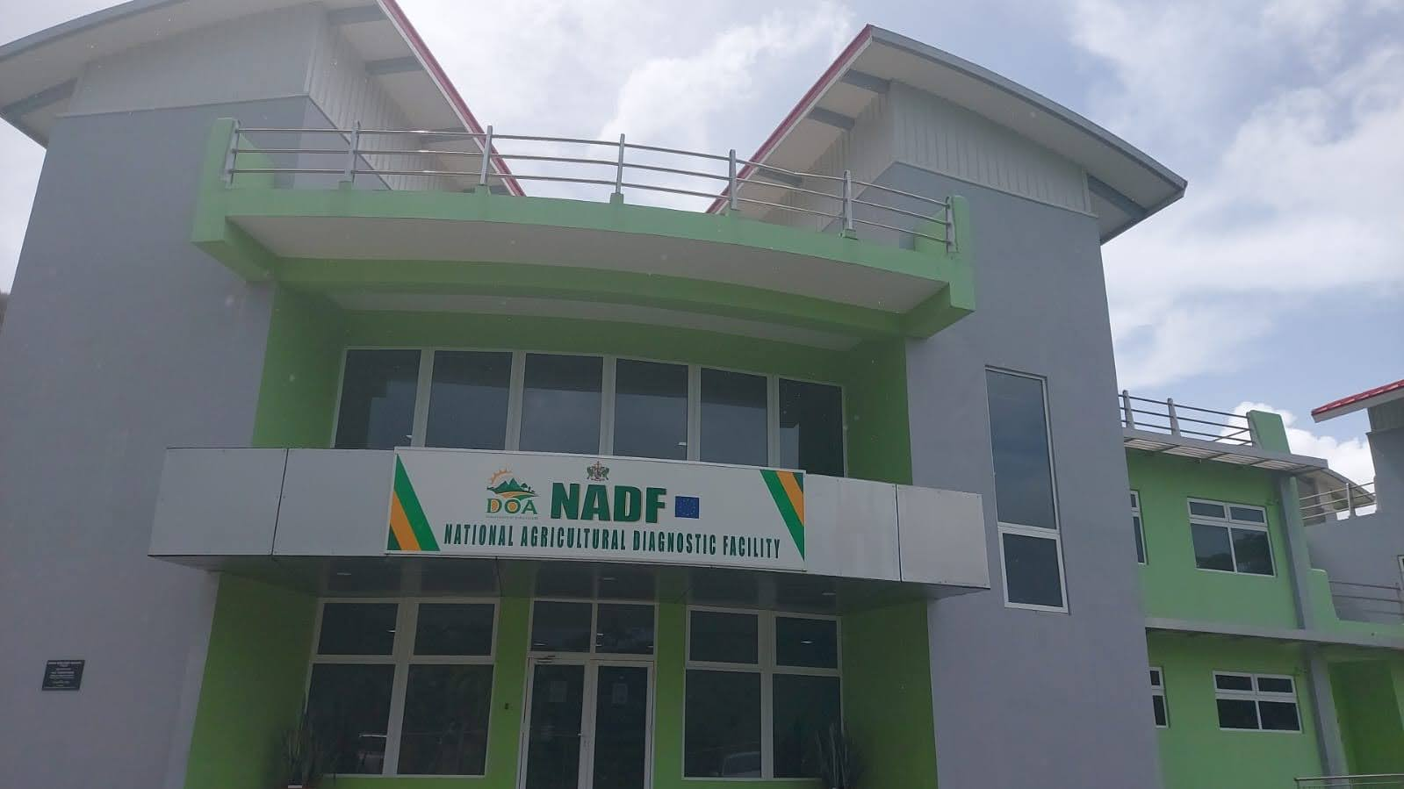
SURVEILLANCE Continued
Establishment of the National Agricultural Diagnostic Facility (NADF)
Animal Health
Plant Health
Feed Testing
Soil Testing
Standards

Slide 20
PUBLIC AWARENESS
Public education is an ongoing activity which entails a series of events through out the year.
Weekly television and radio programs
Quarantine awareness month
‘Don’t Pack a Pest’ campaign which targets travelers.

Slide 21
INVASIVE SPECIES
Invasive species of note which could have a negative impact on the country’s biodiversity.
The presence of the green iguana on island is worrisome.
Likewise the sightings of Tufted Capuchin Monkey and Green Monkey troops in the wild.

Slide 22
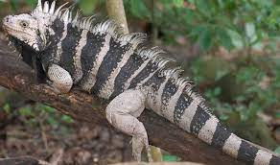
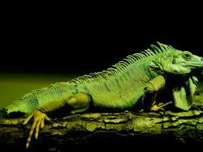
Invasive species continue
Indigenous St. Lucian Iguana
Invasive Green Iguana

Slide 23
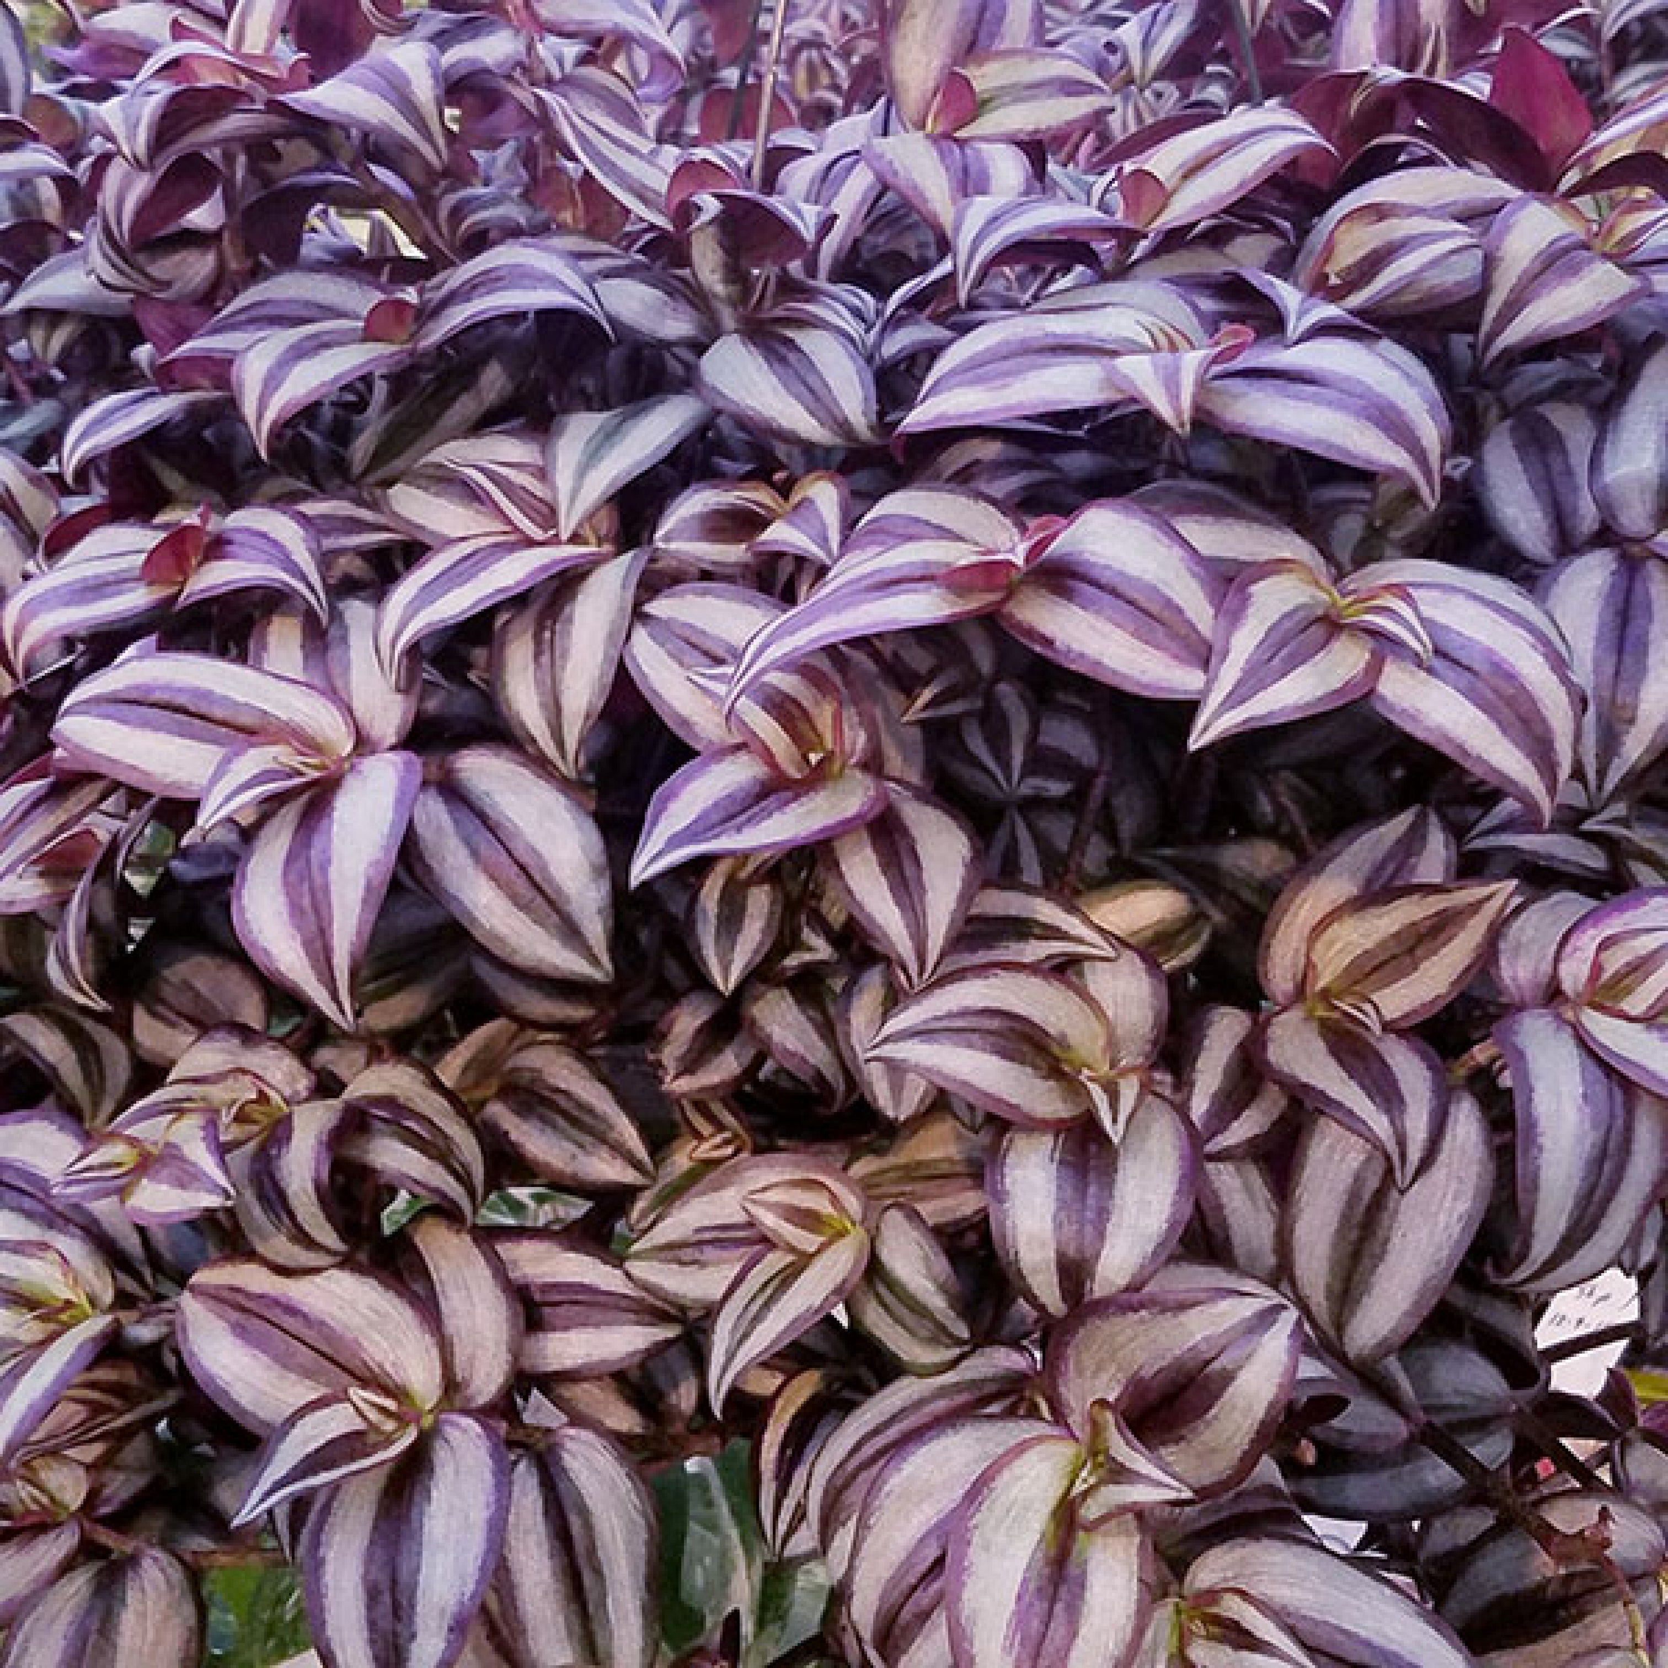
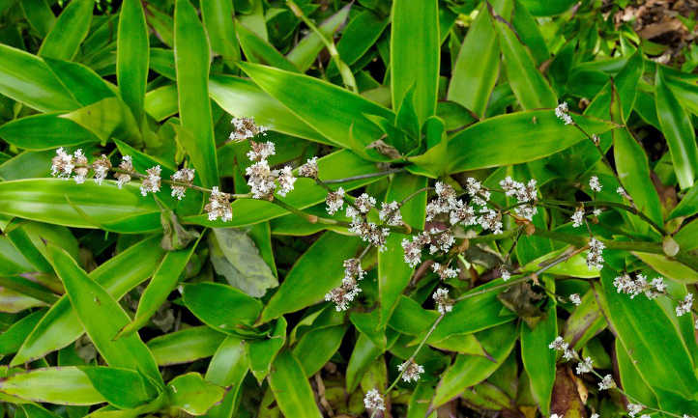
Two invasive plants on Gros Piton
Wandering Jew
Callisia fragans

Slide 24
Invasive species continue
Threats of invasive species to the island include but not limited to
Competition with indigenous species for food and habitat
Agricultural pest
Imbalance in the local ecosystem
Loss of biodiversity

Slide 25
THANK YOU

Slide 26
QUESTIONS?

