Slide 1
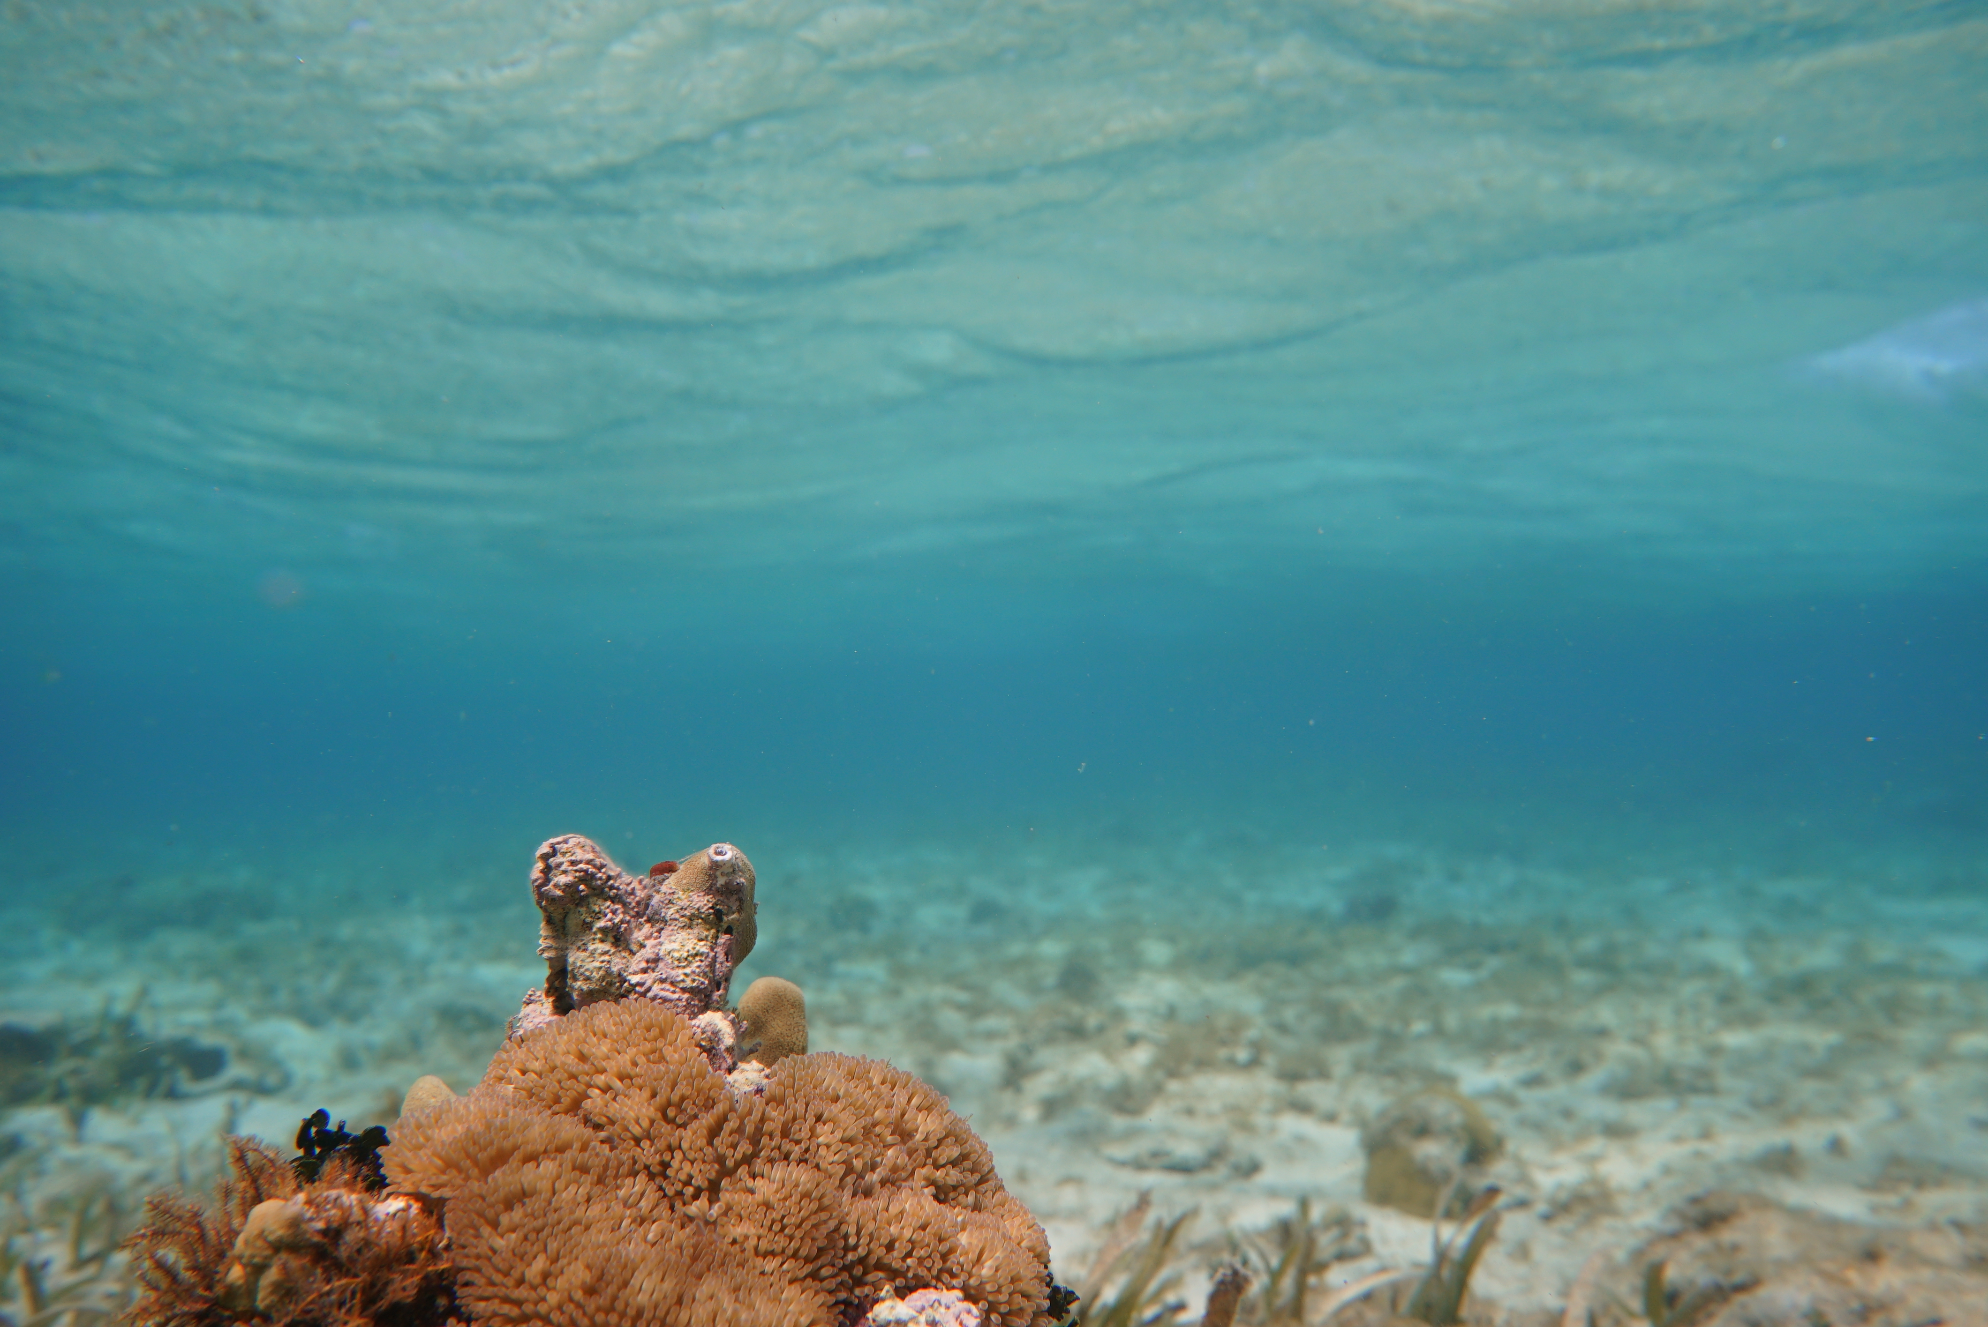

About the CBF
Karen McDonald Gayle
CEO

Slide 2

History
Established in 2012, the Caribbean Biodiversity Fund (CBF) is the realization of a bold vision to create reliable, long-term funding for conservation and sustainable development in the Caribbean region.
The CBF was formed to support the Caribbean Challenge Initiative (CCI), a regional, voluntary commitment launched in 2008 at the Conference of the Parties of the Convention on Biological Diversity (CBD COP-9) with two goals:
The 20-by-20 goal to effectively conserve and manage at least 20% of the marine and coastal environment by 2020.
The sustainable finance goal to establish fully functioning sustainable financial mechanisms that will provide reliable funding over the long term.

Slide 3
About
The CBF is
an umbrella environmental fund with a
flexible structure to
implement innovative solutions for
resource mobilization in the Caribbean through a
range of financial instruments.
Currently, the CBF manages about US$125 million through
its Conservation Finance and the Climate Change Programs.
The CBF and a group of National Conservation Trust Funds (NCTFs) together form the Caribbean Sustainable Finance Architecture.

Slide 4
Mission
Vision
Our mission is to ensure continuous funding for conservation and sustainable development in the Caribbean.
A Caribbean region where both its natural environment and people thrive.

Slide 5


Programs

Slide 6
Current CBF Programs
CONSERVATION FINANCE (2012) | CLIMATE CHANGE (2016) | NATURE BASED ECONOMIES (2022)
Instruments Endowment, Projects Commitments to date 69.5M USD Market Value 97M USD Donors KfW, TNC, GEF/WB, AFD/FFEM GAC, USAID, GEF/UNEP | Instruments EbA Sinking Fund Commitments to date: 50M USD Donors KfW | Instruments ACE Sinking Fund Commitments to date: 25.5M USD Donors KfW

Slide 7
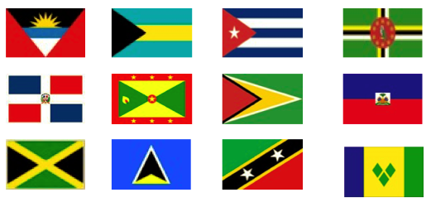

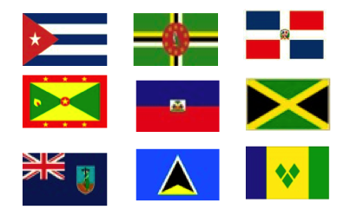
Programs by Country
CONSERVATION FINANCE (2012) | CLIMATE CHANGE (2016) | NATURE BASED ECONOMIES (2022)
Instruments Endowment, Projects | Instruments EbA Sinking Fund | Instruments ACE Sinking Fund

Slide 8
Advancing Circular Economy (ACE) Facility
New USD 30M funding window for circular economy interventions promoting marine conservation under the CBF’s ACE Facility
Financed by the German Federal Ministry for Economic Cooperation and Development through the German Development Bank KfW.
Objective
Contribute to the reduction of marine pollution in the Caribbean through the promotion of sustainable circular economy interventions.
Expected Start: June 2022
Beneficiaries NGOs, universities, government institutions, civil society organizations, SME, consortia
Countries Cuba, Dominica, Dominican Republic, Grenada, Haiti, Jamaica, Montserrat, Saint Lucia, Saint Vincent & the Grenadines
Financing range USD 400,000 – 2M
Implementation 36 months
Eligible activities Equipment, infrastructure, capacity building / knowledge development, policy, research / data, project management
Mechanism: 2 CfPs
NATURE BASED ECONOMIES PROGRAM

Slide 9
EbA Facility – Strategic Approach
Sustainably manage EbA supporting marine and coastal zone habitats, incorporating social and economic resilience to climate change (SO#1)
Rehabilitate and restore EbA-supporting marine and coastal zone habitats incorporating social and economic resilience to climate change (SO#2)
Focus on coastal and marine ecosystems
CLIMATE CHANGE PROGRAM

Slide 10
CBF Endowment Fund
Investment and management of funding for conservation and effective management of biodiversity and natural resources in the Caribbean
Currently at 12 Country Sub Accounts. Access through 5-year Partnership Agreement with CBF-eligible National Conservation Trust Funds, who in turn lead grant-making programs in communities and at the national level
Key principles
Partners create new finance mechanisms that provide a minimum 1:1 match to the CBF Endowment payments
CONSERVATION FINANCE PROGRAM

Slide 11
CBF Endowment Resources (Jan 2022)

Slide 12


Slide 13
Where we started - 2015
NCTFs Status | Legally Established | Functional Board | Pre-Financing Agreement | By-laws | OM (Board Approved) | Staff Hiring | CBF Eligibility Request | Partnership Agreement Negotiations | First CBF Payment
MEPA Trust
BPAF
Fondo MARENA |  |  | Not applicable
GSDTF
NCTFJ
SCNCF
SLUNCF
SVGCF

Slide 14
Where we are today
Country | Funds | Legally Established | Functional Board | Pre-Financing Agreement | By-laws | OM (Board Approved) | Staff Hiring | CBF Eligibility Request | Partnership Agreement Negotiation | First CBF Payment | CBF-funded grants awarded
A&B | MEPA
Bah | BPAF |  |  | Not applicable
Cuba | n/a |  |  | TBD
Dominica |  |  |  | TBD
Dom Rep | MARENA |  |  | Not applicable
Grenada | GSDTF
Guyana | GPAT |  |  | Not Applicable
Haiti | FHB |  |  | Not Applicable
Jamaica | NCTFJ
Kitts/Nevis | SCNCF
Lucia | SLUNCF
Vin/Gren. | SVGCF

Slide 15
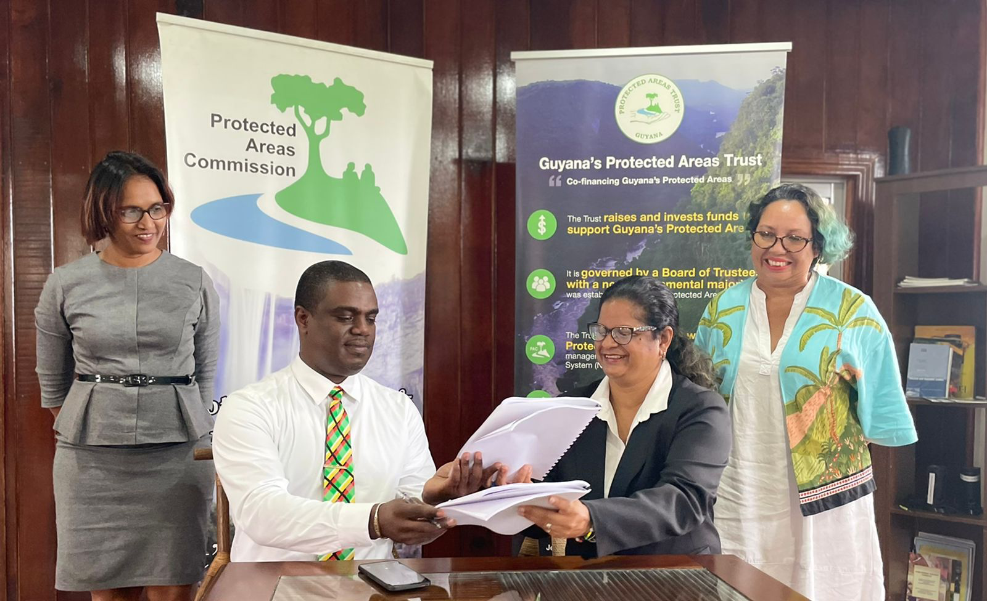

CBF-GPAT Partnership Agreement - May 2022!

Slide 16


Projects

Slide 18
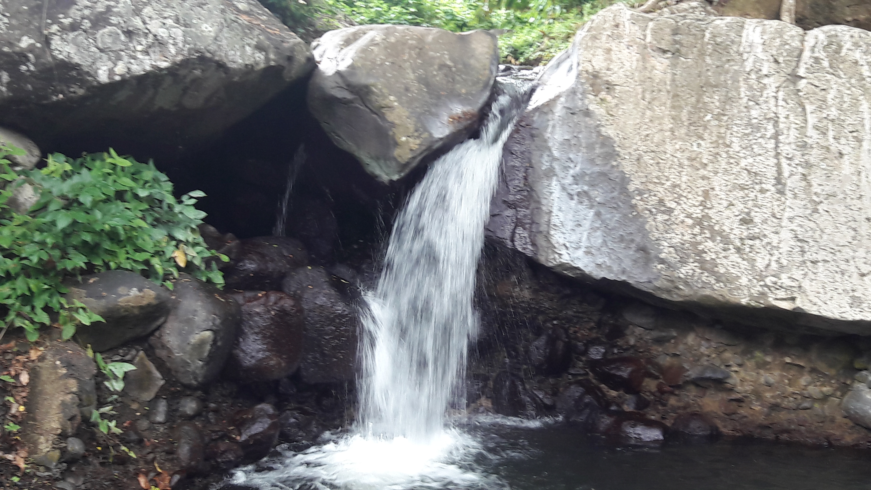

Looking forward

Slide 19
Continued Growth and Evolution
Partners
Conservation Themes
Geographies
Strategic Planning
Disaster Recovery ”window(s)” for Conservation
Results Management and Learning Systems
Caribbean Private Sector Investment in Finance Mechanisms

Slide 20
Continued Growth and Evolution
New Policies
    Environmental & Social Safeguards
    Gender
New NCTFs
    Dominica
    Cuba
New Sub Accounts
  Caribbean Invasive Species
  Caribbean Biological Corridor
New Partners
Wayaj, Inc
Caribbean Climate Smart Accelerator
CARICOM

Slide 21
CONTACT
kmcdonaldgayle@caribbeanbiodiversityfund.org
www.caribbeanbiodiversityfund.org

