Slide 1
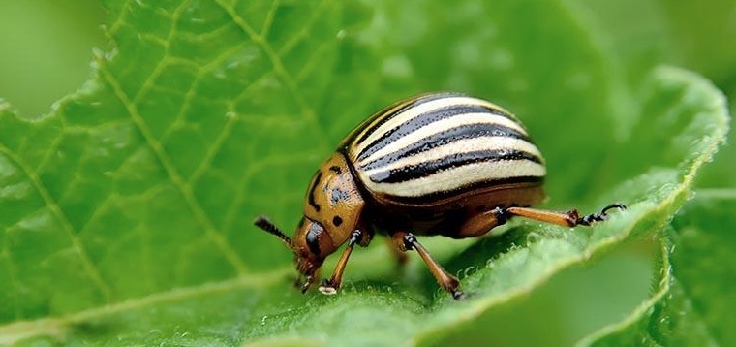
CABI Pest Risk Analysis Tool
Risk Communication
June 2022

Slide 2
How do you communicate risk?
Existing communication methods
Whatsapp – dedicated WhatsApp group
Email
CAPHSA network
St Kitts and Nevis – weekly subscription to WTO alerts
USDA

Slide 3
SWOT for communication
Strength
Share information efficiently/quickly
Increase transparency
Pool skills and resources
Gain use of credible sources
Efficient decisión making
Awareness
Weaknesses
Not enough resources/time
Individual in different roles
High turnover of staff
Overload of options for communication
Communication linkage
Little to no stakeholder involvement
No guidelines on how to communicated
Opportunities
Can start to créate better linkages with stakeholders
Could inform regulation on how to communicate better? E.g. where does a PRA go once it’s created for an import?
Encourage circulation of PRAs (e.g. even drafts)
Contributing to single trading arrangement guidelines
Strengthen already existing forms of communication
Threats
Disrupting trade
Lose status of being pest free once publicised

Slide 4
SWOT for communication
Strength
There’re already links among the territories so sharing threats will be useful
Develop projects collaboratively among territories
Sharing pest alerts to be ready/prepared
Time saving by sharing PRAs
Sharing expertise among biosecurity teams
Weaknesses
Data sharing restrictions for Government. Sharing critical pest alerts will need permission. But procedures, templates, PRAs could be possible.
Limited time of staff members to help other territories. Particularly for taxonomists
Gov internet block certain Internet services and software (barracuda)
Financial constraints to sustain network
Internet not available/reliable out in the field or in some key áreas (airport )
Must use personal phones and data
Opportunities
Increase confidence levels on PRA by collaborative work, review, sharing..
Produce common reports and templates, procedures
MoU to share critical/essential information (pest alerts)
Staff Exchange and attachments
Potential regional meetings – all together
Sharing professional networks
Increase internal communication (e.g. Env-Agric)
Sharing lab resources and species identification
Capacity building
Sharing experience with technology and recommendation of Good practices and management
Threats
sharing confidential information (financial, personal…)
Hacking repositories
High staff turn-over
Natural disasters
Political will to finance the communication activities. Difficult to convince them if it isnt related to key aspects (e.g. tourism)

Slide 5
Communication into procedures
When do we trigger communication in the PRA procedure?
Ask others, have you already assessed this? Could we work jointly?
New import type
New import región
New pest alert
If Horizon Scanning is conducted, could share results
PRA completed, upload a draft, ask for comments
When management Measures are considered, can ask if they have been used elsewhere and if they were effective

Slide 6
Other communication
Sharing literature and reports relevant to biosecurity
Sharing pest alerts or internal reports when permission is given

Slide 7
At initiation stage
Query for species identification (e.g. picture) for accidental introduction or interceptions
Keep list of taxonomists that could be approached
Access PRA repository in PRA Tool
Query biosecurity network for information on the species via e-mail group?
Share a screening form completed if it was positive or negative

Slide 8
After a rapid PRA is complete
After finishing draft of the rapid PARA, share to get comments and feedback if necessary (e.g. not confident enough).
Try to be specific about the feedback required.
Remove personal information before sending or sharing

Slide 9
After a full PRA is drafted
Maintain consultant database for peer review requests
Flexible process to add to list
Consultant/company contact details, expertise taxonomy/commodity, territory, annex: CV or portfolio of projects

Slide 10
After a full PRA complete
PRA in a repository?
Confidentiality / Personal information
Combine repository with other Caribbean countries
Required to have internal permission from department?
Announce the availability of new resource in the e-mail group

Slide 11
General communication Tools

Slide 12
Communication, Data and knowledge sharing
Activity | How | Who | When
Instant Messaging (e.g. pest alerts) | WhatsApp | Quincy | Now
Queries / announcements / general messages | WhatsApp
Reports and data repository | Email? CPHD PRA Tool (so long as you start the PRA within the Team) |  | Once everyone has received the participant list email addresses

Slide 13
Communication, Data and knowledge sharing
Activity | How | Who | When
Regular online meetings | Zoom | Everyone? | Whenever the need arises for joint discussion
Staff exchanges and visits
Consultant database | WhatApp | Whoever needs information should ask the group | When consultant required
Taxonomist database | WhatsApp | Whoever needs the contact of a taxonomist should ask the group | When specialist taxonomist required

Slide 14
Time to setup a group?

