Slide 1
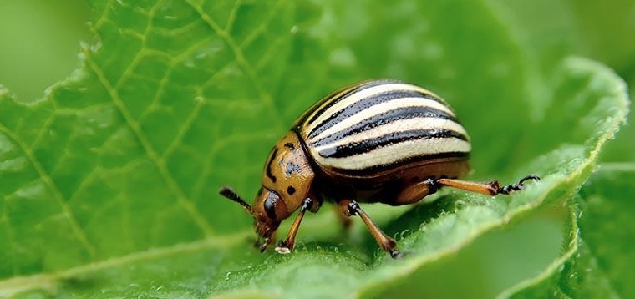
CABI Pest Risk Analysis Tool
Risk Management
June 202

Slide 2
Conclusions of pest risk assessment
Risk acceptable? PRA ends
Risk unacceptable? PRA continues
Identifying options
Evaluating options
Selecting options

Slide 3
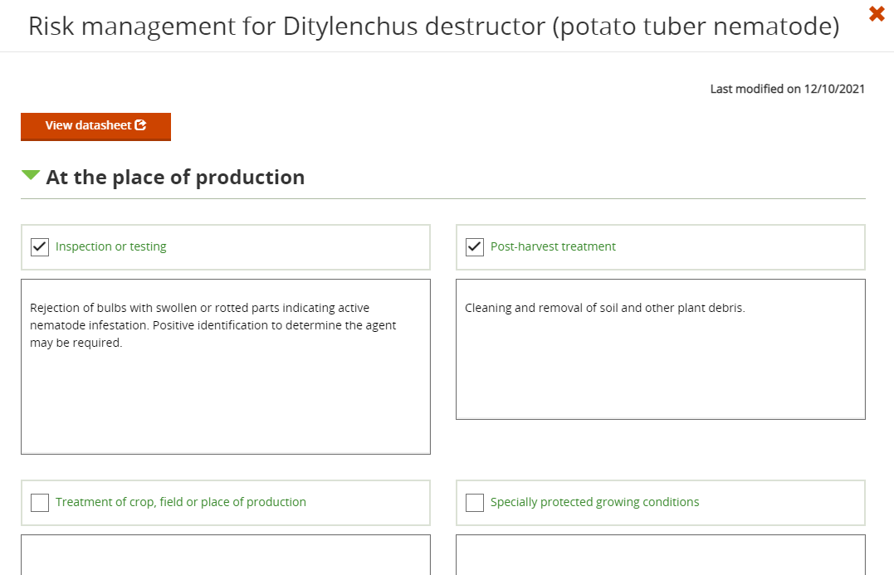
Risk Management
Phytosanitary measures can be assigned to each pest or pathway in the risk analysis
Further options and a summary section follow…

Slide 4
Sources of information
ISC and CPC
other online databases such as GISD (http://www.iucngisd.org/gisd/) or PIER (http://www.hear.org/pier/)
NPPOs datasheets/brochures/farmer extension materials
specific literature on commodities or individual pests/diseases

Slide 5
Measures
Measures can be implemented
for individual pathways
at specific commodities or associated materials
at origin or in the exporting country
at the point of entry
within the importing country or invaded area

Slide 6
Pathways
Consider all pathways
Traded plants or plant products
Natural spread of the pest
Entry with human travellers
Vehicular transport
Associated materials
Identify points at which mitigation measures might be applied
Identify possible mitigation measures at each point
Assess each for effectiveness, efficiency and feasibility ….
Select appropriate measure(s)

Slide 7
Country of origin
Area of production
Recorded presence/absence of pest/disease in region of production
General or pest specific surveillance
Official measures to maintain pest free status (documented through certificate)
Crop measures
Treatment of the crop, field or place of production
Growing plants under protected conditions to prevent infestation of the crop
Specifying time of harvest
Phytosanitary certification

Slide 8
Country of origin (cont.)
Commodity Measures
Inspection or laboratory tests
Prohibition of parts of the host
Restricting the composition of a consignment
Pre shipment quarantine
Specified conditions for preparing the consignment
Treatment for removal of pest(s)General or pest specific surveillance
Pathway measures
Targeted inspections, publicity and fines or incentives
Measures for machinery, modes of transportation, or packaging

Slide 9
In transit
Commodity Measures
Storage conditions may be specified
Temperature, packaging, separation from other specified plants etc.
Fumigation or other chemical treatment on board ship
Ship inspection before loading or at destination

Slide 10
Country of destination
Prohibition of a specific commodity from specific source
Only if no treatments or inspection techniques are available and effective in reducing risk to acceptable levels
A measure of last resort
IPPC principles of necessity, science based, managed risk and minimal impact
Documentation
Phytosanitary Certificates
Official assurance that specified import requirements are met
Confirms that risk management measures have been taken
Only for regulated articles
Import permits, IPPC stamp for SWP
Phytosanitary Certificates
Awareness raising
Educate & inform travellers, importers, industry, government or public

Slide 11
Selecting appropriate measures
Phytosanitary measures should be:
cost effective & feasible
no more trade restrictive than necessary (minimal impact)
not imposed if existing measures are effective
Different measures with the same effect should be accepted as alternatives
For pests/diseases already present: import measures should be no more restrictive than measures applied within PRA area

Slide 12
Evaluating options
Evaluate each option for:
Effectiveness
Efficiency
Cost effectiveness
Feasibility
Reproducibility
Potential negative social, economic or environmental consequences

Slide 13
Conclusion of PRA
Pest risk management conclusion:
selection of one of more mitigation measures or series of measures in place, OR
selection of one of more mitigation measures or series of measures to be implemented, OR
no suitable mitigation measures available
PRA can ends in all cases with recommendations (next steps):
keep status quo
implement suitable and feasible additional measures and integrate in existing biosecurity procedures (this can include prohibition!)
initiate research to develop suitable mitigation measures

