Slide 1
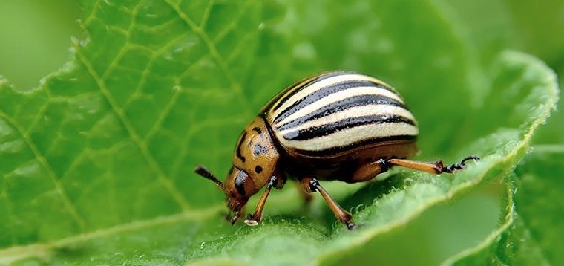
CABI Pest Risk Analysis Tool
Introduction to the tool
October 2021

Slide 2
Help and feedback
Introduction
PRA workflow
Creating a team
Working offline
Pest Risk Analysis Tool​
Provides a workflow
To assess pest risks and select appropriate phytosanitary measures
For reducing the risk of pest introduction
Designed for risk assessors and risk managers in NPPOs
Provided as an add-on to a CPC subscription
Free to NPPOs in lower-income countries

Slide 3
Help and feedback
Introduction
PRA workflow
Creating a team
Working offline
Main features
Framework that follows the international standards of IPPC (ISPMs 2 and 11)
PRA initiation 'By Pathway' or 'By Pest’
Generation of plant commodity pest lists
Facilities for users to add new pest information
Links to CPC datasheets
Template for risk assessments for individual pests
Template to assign risk management measures to pests or pathways
PRA report generator
Flexible team working online and offline

Slide 4
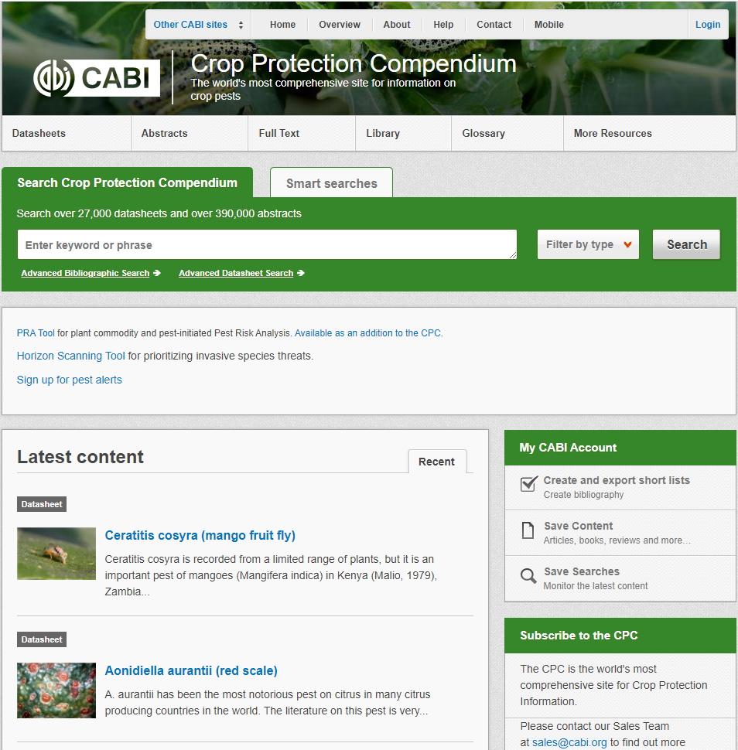
Help and feedback
Introduction
PRA workflow
Creating a team
Working offline
www.cabi.org/PRA-Tool
Or access from a link from the
Home page of the CPC
Notes:
Search in browser for “CABI PRA Tool”

Slide 5
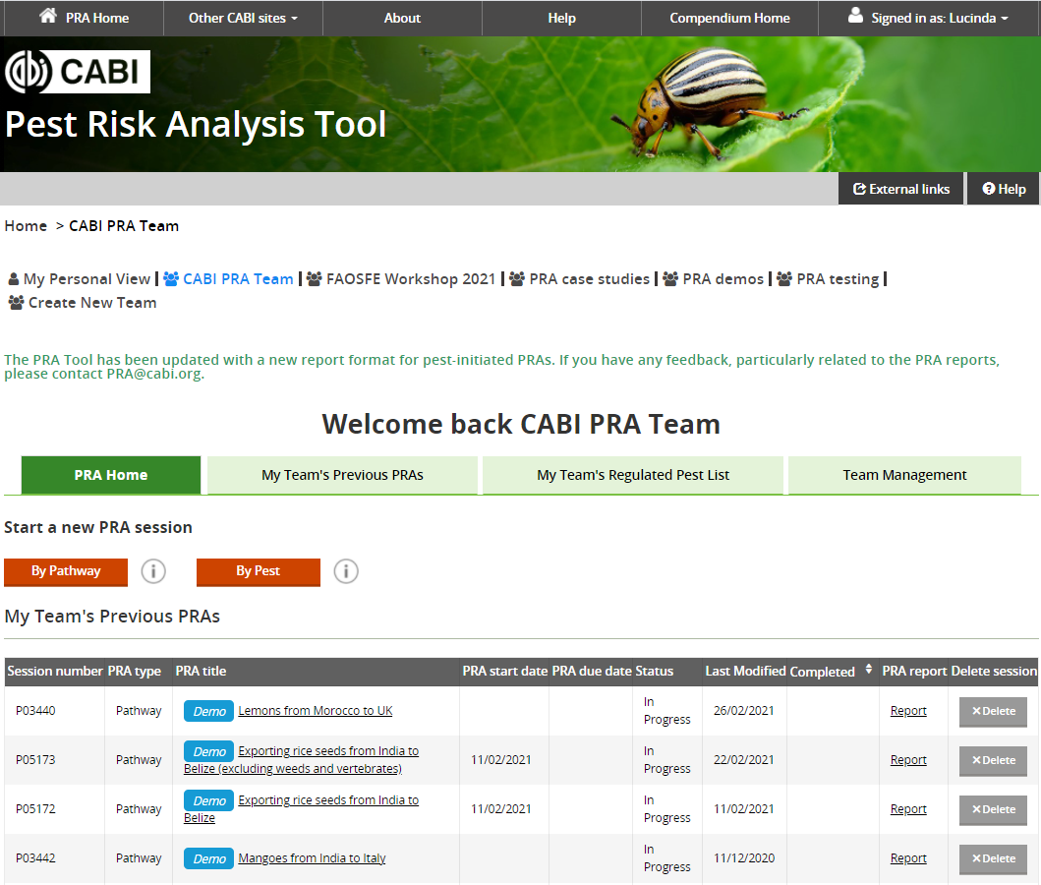
Help and feedback
Introduction
PRA workflow
Creating a team
Working offline
PRA Tool
home page
Select view for personal or team PRAs
Start a new PRA for a plant commodity pathway or a pest of concern
Go directly to the PRA Report
The last 5 edited PRAs

Slide 6
PRA initiation
Help and feedback
Introduction
PRA workflow
Creating a team
Working offline
By Pathway
E.g. a request to import onions from South Africa to Zambia
By Pest
E.g. risk of red palm weevil (Rhynchophorus ferrugineus) for Ghana
Identify the pests that are associated with the pathway
Identify the potential pathways for pest entry to the risk area
Pest 1
Pest 2
Pest 3
Pest ...
Pathway 1
Pathway 2
Pathway 3
Pathway ...
Conduct a risk assessment for all the major pests that may be introduced to the risk area via this pathway
Assess the likelihood of introduction of the pest via each pathway. Then continue the single pest risk assessment
Notes:
The PRA Tool currently has two workflows for conducting a PRA: ‘By Pathway’ or ‘By Pest’:
A pathway-initiated PRA is focused on a single pathway which may have multiple pests associated with it. This type commonly arises from a request to import a new plant commodity or a commodity from a new country of origin.
A pest-initiated PRA is focused on a particular pest that may have multiple pathways of entry. This type may arise from a new information about the pest, a pest alert, interception or the results of a horizon scanning exercise.

Slide 7
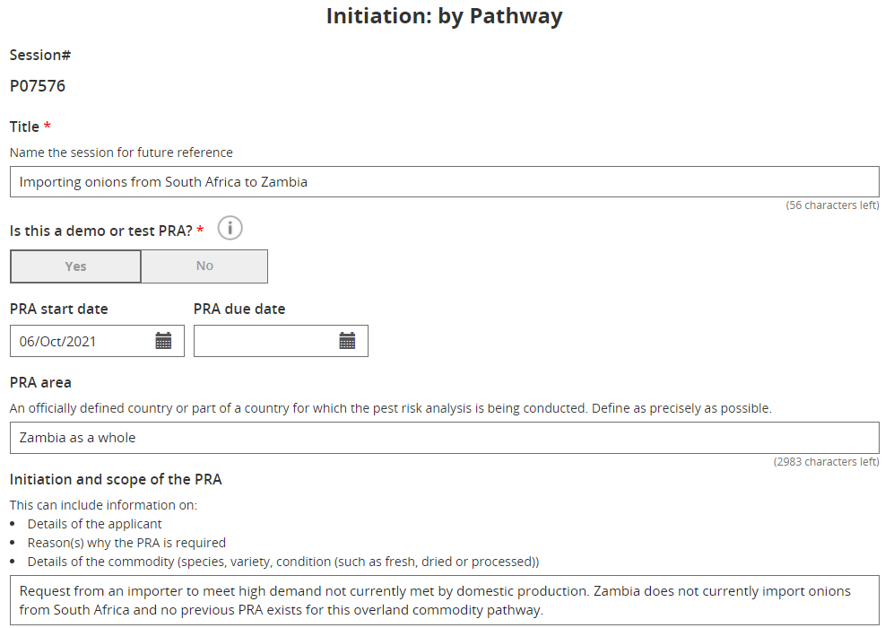
Help and feedback
Introduction
PRA workflow
Creating a team
Working offline
Documenting initiation
Reason for the PRA
Other background information

Slide 8
Help and feedback
Introduction
PRA workflow
Creating a team
Working offline
Demo mode
Can be selected when you start a new PRA
Information you enter in that PRA will not be connected to any other PRAs created in the tool or the ‘Regulated Pest List’
Included for demonstration and learning purposes
PRAs created in this mode are indicated by
When a user modifies the distribution or regulatory status of a pest in ‘live’ mode in a By Pathway PRA, that status will overrule the CPC in future pathway-initiated PRAs
Select ‘Demo’ mode to ignore changes made in that PRA session

Slide 9
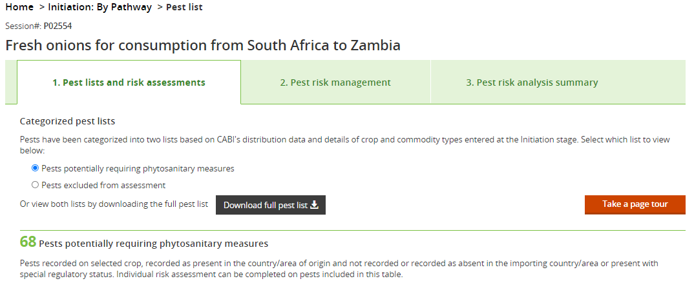
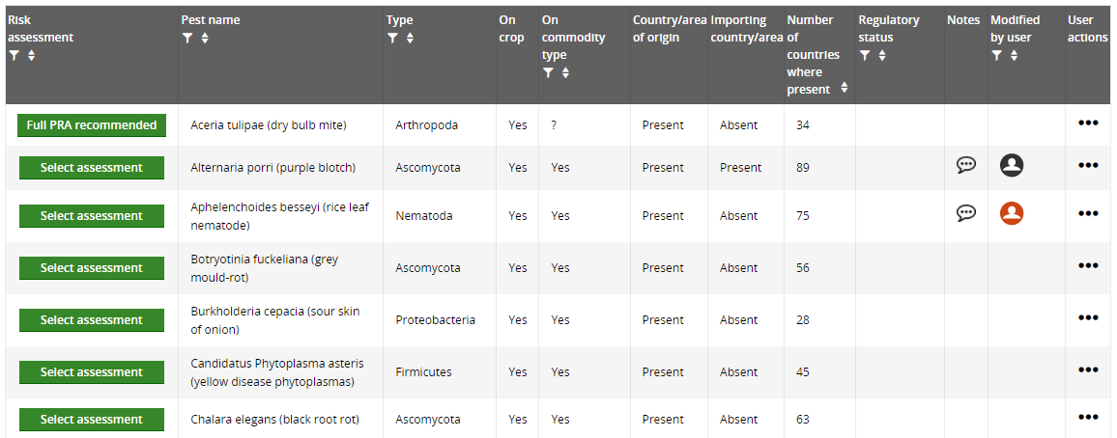
Help and feedback
Introduction
PRA workflow
Creating a team
Working offline
Generating a pest list for a plant commodity pathway
Pests are generated using the CPC host and distribution data but can be modified by the risk assessor to overrule the CPC
Notes:
We will look at the options for working with the pest lists in more detail in the Pathway-initiated PRA slide set.

Slide 10
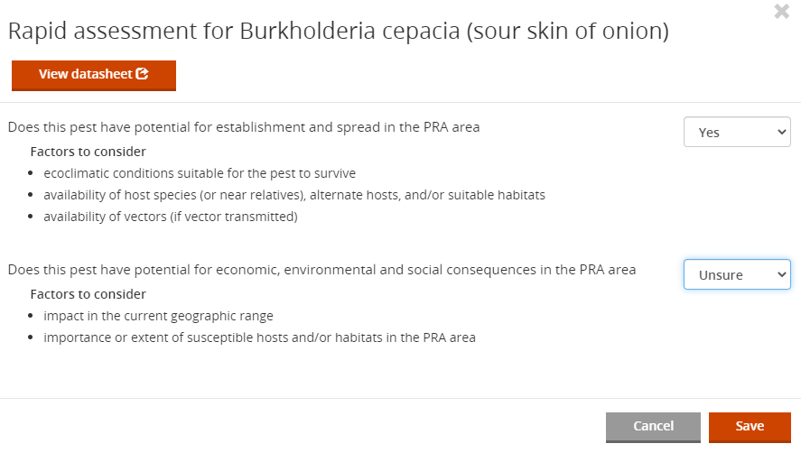
Help and feedback
Introduction
PRA workflow
Creating a team
Working offline
Pest categorization
Does the pest potentially require phytosanitary measures?
Yes (or unsure) – the PRA continues
No – the PRA stops
Templates provide a framework for working logically through a PRA and documenting the analysis

Slide 11
Help and feedback
Introduction
PRA workflow
Creating a team
Working offline
Risk Assessment
Select ratings and confidence levels
Risk assessment forms are accessed from tabs aligned to the steps in ISPM 11
Enter scientific evidence for the rating in text boxes. The References section is accessed at the bottom of the page
Further questions and a summary section follow…
Notes:
We will explore these in more detail when we look at the pest and pathway PRA workflows.
The risk assessment steps are:
Probability of entry
Probability of establishment
Probability of spread
Potential consequences (economic, environmental and social)
The bar at the top can be used to navigate backwards and forwards in the PRA. Steps and questions can be completed in any order. The ‘Save’ button is at the bottom, please save regularly.

Slide 12
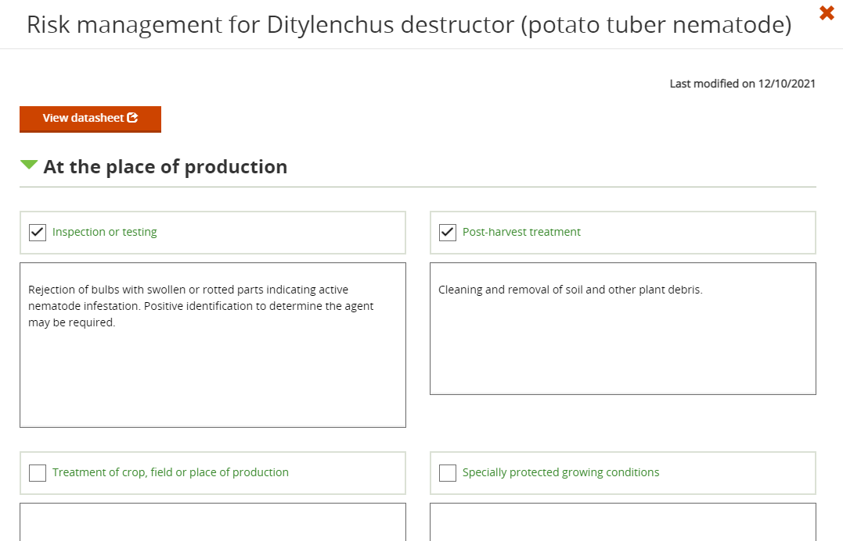
Help and feedback
Introduction
PRA workflow
Creating a team
Working offline
Risk Management
Phytosanitary measures can be assigned to each pest or pathway in the risk analysis
Further options and a summary section follow…

Slide 13
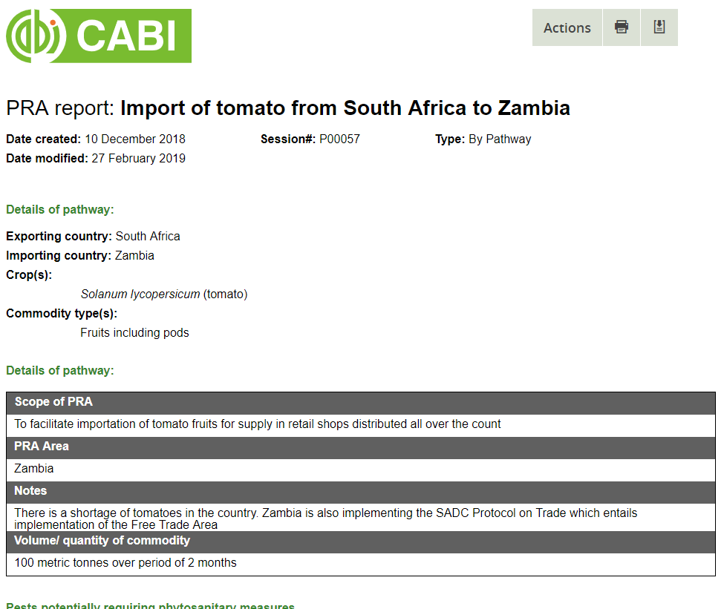
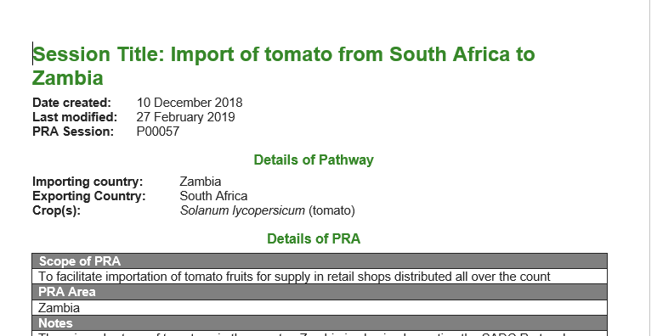
Help and feedback
Introduction
PRA workflow
Creating a team
Working offline
HTML format
PRA Reports
Word format

Slide 14
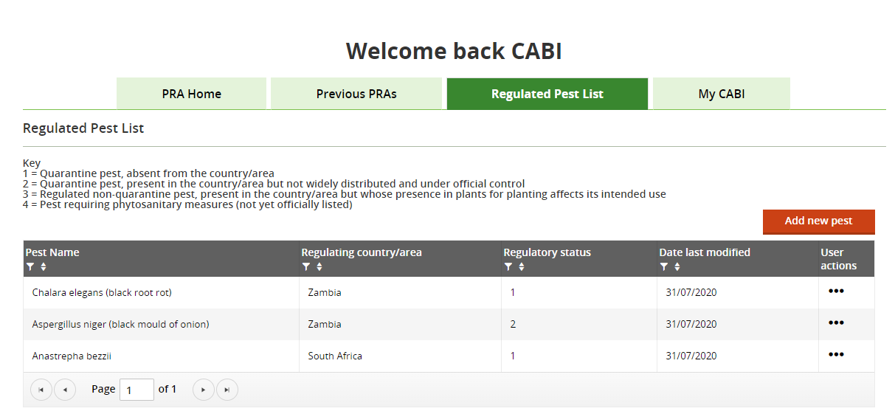
Help and feedback
Introduction
PRA workflow
Creating a team
Working offline
Regulated Pest List
Build a list of quarantine pests for use in future pathway pest lists
Notes:
Build a list of quarantine and other regulated pests in the tool for use in future PRAs. Pests can be selected from the Compendium picklist to add a regulatory status for a country and a saved record can be edited to update that status here. Regulatory status can also be added and updated in pathway PRAs that have not been created in ‘Demo’ mode. The last saved status for a pest + country combination will be shown in this tab and used in future pest lists that are generated for new pathway PRAs. Once a pathway PRA pest list has been generated, updates made outside that PRA will not be applied.
If you wish to add a pest that is not available in the picklist and have checked its synonyms in the CPC, please contact PRA@cabi.org to have the pest added to the Compendium by the editorial team.
Please note that the ‘Regulated Pest List’ is not currently linked to ‘By Pest’ PRAs.

Slide 15
Help and feedback
Introduction
PRA workflow
Creating a team
Working offline
Team working online
Select to view PRAs created in different teams
Create a PRA team
It is recommended that a single team is created for the NPPO PRA unit to include all the regular risk assessors that need to collaborate on PRAs
There is no sharing between the different views and only one version of each PRA
Invite members to join by email
Notes:
Team working online
Every user can create a team to work together on PRAs. To access the team’s PRAs, each team member requires access to the CPC and the PRA Tool and their own ‘My CABI’ account as they will be working online in the tool. Each member will then be able to access the full functionality of the tool to create, edit and download PRAs and regulated pest lists saved by that team.

Slide 16
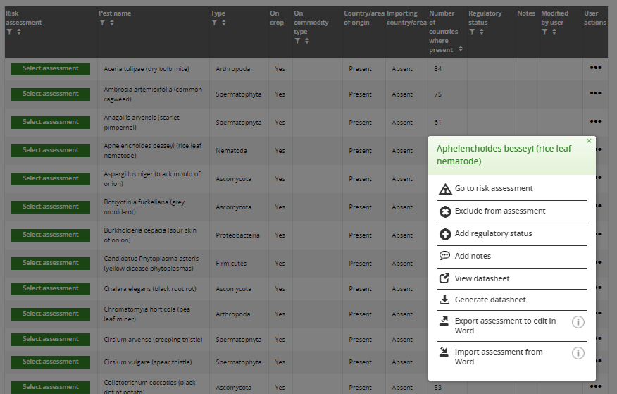
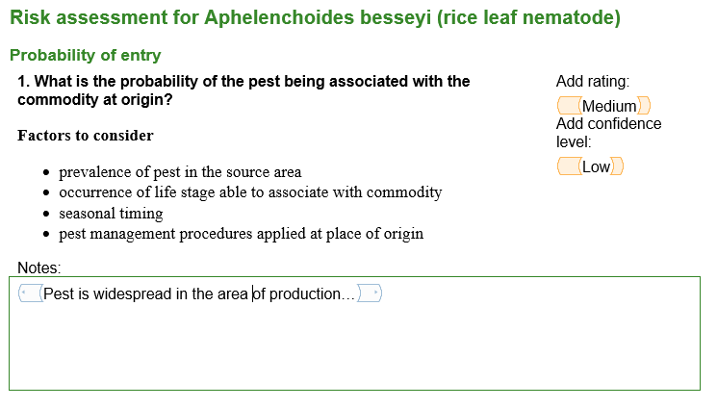
Help and feedback
Introduction
PRA workflow
Creating a team
Working offline
Team working offline
An option to export the risk assessment to edit in Word and import back into the tool is provided for individual pests in both PRA workflows
Notes:
An MS Word version of the risk assessment form for an individual pest is available to export from pathway- and pest-initiated PRAs. This form can be edited without internet access, and by anyone you choose to share it with, and then imported back into the same PRA for completion online. The imported version will overwrite the online content.
To access this export/import option in a pathway PRA please go to the User actions menu in the pest list. In the pest-initiated PRA it can be found on the Probability of entry page.
A PDF copy of the Compendium datasheet can also be generated to assist the research while working offline.
If there is no intention to continue editing online, the PRA report (draft or completed) can be downloaded in MS Word and the full pest list that is generated for a pathway-initiated PRA is also available as a CSV download which can be opened in Excel.

Slide 17
Help and feedback
Introduction
PRA workflow
Creating a team
Working offline
External links
www.cabi.org/PRA-Tool/externallinks
Help and training materials
www.cabi.org/PRA-Tool/help
Queries and feedback to CABI
PRA@cabi.org

