Slide 1
CABI Horizon Scanning Tool
Introduction
October 2021

Slide 2
Help and feedback
Horizon scanning
The CABI tool
Conducting a scan
Scan results
Definition of horizon scanning
A systematic examination of potential threats and opportunities within a given context
In this case:
Potential threat = invasive species
Given context = agriculture, forestry and environment

Slide 3
Help and feedback
Horizon scanning
The CABI tool
Prioritization example
Conducting a scan
Scan results
Identifies potential invasive species threats to a country, state or province
Using information from CABI Compendia datasheets
Area at risk: species not recorded as present
Source areas: species recorded as present in one or more
Notes:
The Horizon Scanning Tool is a decision support tool that helps identify potential invasive species threats to a country, state or province by comparing species lists from selected source areas to a country or state/province at risk.
The list of species can be filtered using various criteria (e.g. pathways, habitats and taxonomy) to focus on potential invasive species that may require more detailed risk assessment, surveillance, public awareness or direct action to prevent their introduction and spread.
Information from CABI Compendia datasheets is used to generate a list of species that are absent from the selected ‘area at risk’ but present in ‘source areas’.
Area at risk: Can be a country or Compendia subnational region. Species in the scan results are not recorded as present in the ‘area at risk’.
Source countries: Allows for multiple selection of countries. Species in the scan results are recorded as ‘present’ in one or more ‘source countries’.

Slide 4
Help and feedback
Horizon scanning
The CABI tool
Conducting a scan
Scan results
Uses of the Horizon Scanning Tool
To prioritize species for pest-initiated PRAs
Which potential invasive pests most urgently need PRAs?
To select representative pests in pathway-initiated PRAs
E.g. Which pests are likely to arrive with commodity X from country Y?
Other utilities
E.g. Which pests are already in neighbouring countries and need surveillance or contingency plans?

Slide 5
Help and feedback
Horizon scanning
The CABI tool
Conducting a scan
Scan results
Video link:
Introduction to the Horizon Scanning Tool (Video)

Slide 6
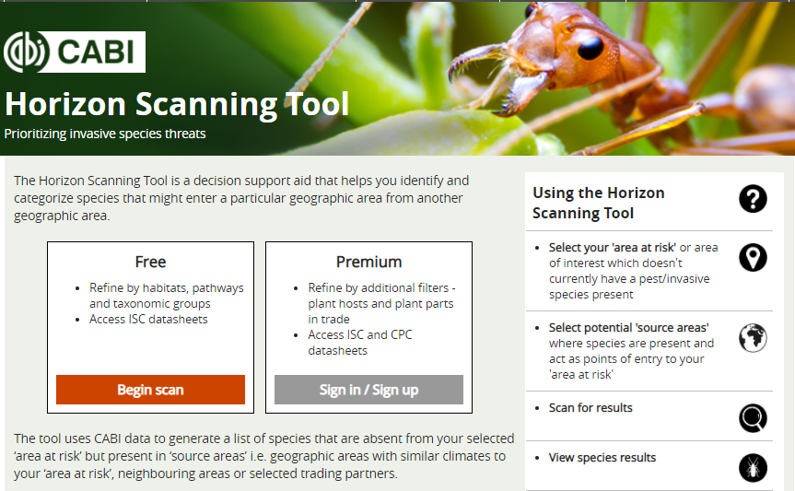
Help and feedback
Horizon scanning
The CABI tool
Conducting a scan
Scan results
Accessing the Horizon Scanning Tool
www.cabi.org/horizonscanningtool
Or via a link from:
Invasive Species Compendium (ISC) toolbox (free version)
www.cabi.org/isc
Crop Protection Compendium (CPC) home page (premium version for subscribers)
www.cabi.org/cpc

Slide 7
Help and feedback
Horizon scanning
The CABI tool
Prioritization example
Conducting a scan
Scan results
Start scan
Area at risk: country or other geographic area can be selected. Species in the scan results are not recorded as present (or are recorded as ‘absent’) in the ‘area at risk’
Option to limit results to plant pests only

Slide 8
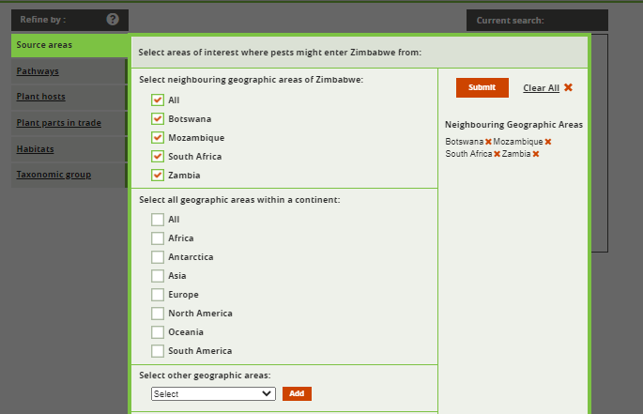
Help and feedback
Horizon scanning
The CABI tool
Prioritization example
Conducting a scan
Scan results
Selecting source countries
Options to select:
Neighbouring countries
All countries within a continent
Individual countries
The list of source areas can be edited before clicking ‘Submit’ to generate the pest list
Notes:
Neighbouring geographic areas are those with land borders only.
Individual countries and the states/provinces of some countries that have Compendia data can be selected from the dropdown selection box.
The selected countries are shown to the right of the screen. Individual countries can be removed from the search by clicking on the ‘x’. which may be useful if you chose all countries in a continent but in fact wanted to remove the island territories for instance.
You can come back to this screen to refine the list of source areas later.

Slide 9
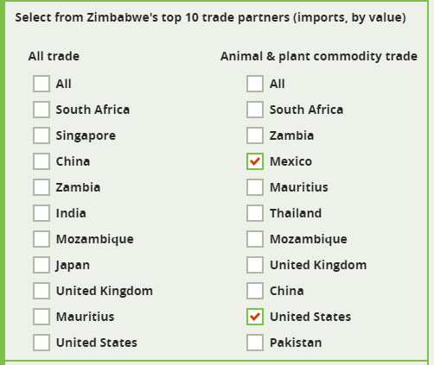
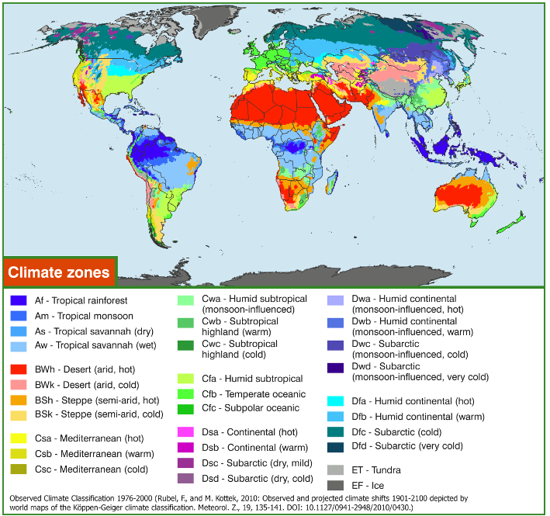
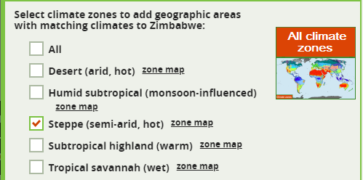
Help and feedback
Horizon scanning
The CABI tool
Conducting a scan
Scan results
Selecting source countries (cont.)
The tool also assists with the selection of:
Trade partners
UN Comtrade data
Countries with matching climate zones
Köppen-Geiger climate classification system
Notes:
Trade partners
The tool presents two lists of trade partners from which the ‘area at risk’ imports goods. The first list considers trade of all commodities and could be used as a general indicator of links between partners. The second list only considers trade of imported animal and plant commodities and so represents a more focused list of partners which could be a potential source of new pests and diseases through imports. The lists are ordered by the total value (in USD) of trade imports.
Matching climates
When an ‘Area at risk’ is selected and construction of a scan is initiated, all the different climate zones found within the ‘Area’ are listed. It is possible to select all or some of those climate zones. As this is done, areas with matching climate zones are listed on the right hand side of the ‘Submit scan’ selection box.
This functionality enables a global scan to be run to include invasive species and crop pests that are present in areas with similar climatic zones to those of the ‘Area at risk’ but are not recorded as present there.
Further details are included in the tool Help page.

Slide 10
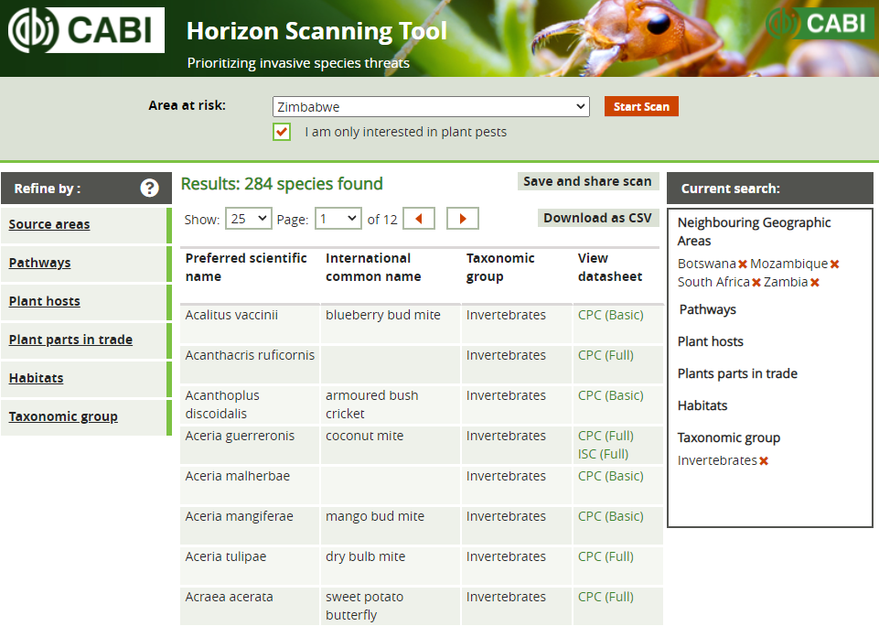
Help and feedback
Horizon scanning
The CABI tool
Conducting a scan
Scan results
Optional filters
Pathways of introduction
Plant hosts*
Plant parts in trade*
Habitats
Taxonomic group
*CPC Premium version only
Selected criteria
Notes:
Pathways: the pathway(s) of introduction - as a ‘stowaway’, ‘contaminant’ or ‘unaided’.
Habitats: the habitat(s) where the species has been recorded (‘terrestrial – managed’, ‘terrestrial - natural/semi-natural’, ‘littoral’, ‘marine’, ‘freshwater’, ‘brackish’, ‘other’).
Taxonomy: uses broad taxonomic groups (‘bacteria’, ‘fungi/Chromista’, ‘invertebrates’, ‘plants’, ‘protozoa’, ‘vertebrates’ and ‘viruses’). Further taxonomic levels (to family) are included in the CSV output.
Plant hosts*: one or more plant hosts may be selected using the scientific or common name. These may of interest because they are hosts at risk of damage or potential pathways of entry. When selecting a crop by common name, please check the scientific name is correct. You may also find that there are multiple entries for common crops under the genus and individual species names, please select all that apply to ensure the pest list is complete.
Plant parts in trade*: the plant parts liable to carry a pest in trade or transport.
*Included in the CPC Premium version only, you must be signed into the CPC to access these filters
Note: when Pathways, Habitats or Plant parts in trade are selected as a filter, the tool will expand your search to include species for which there are no data available. These are incomplete datasets and selecting some options may not reduce your total results by many species. The scan results and CSV output indicate the sections that are missing for each species.
You can extend the scan or narrow the results list by revisiting the filters or removing entries from the Current search by clicking on the ‘x’ after the term.

Slide 11
Help and feedback
Horizon scanning
The CABI tool
Conducting a scan
Scan results
Refining the scan
Extend the scan or narrow the results
Or remove selected criteria by clicking ‘x’
Revisit the filters
Notes:
You can extend the scan or narrow the results list by revisiting the filters or removing entries from the Current search by clicking on the ‘x’ after the term. Or you can analyse the results in a spreadsheet format.

Slide 12
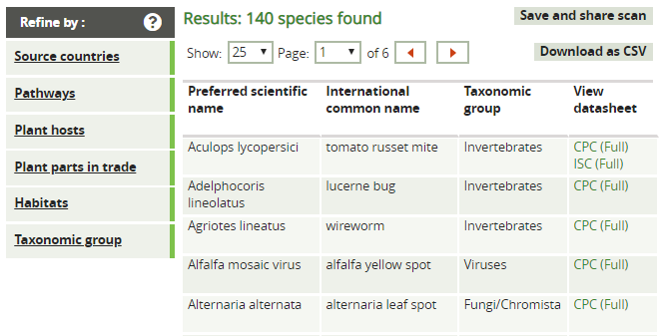
Help and feedback
Horizon scanning
The CABI tool
Conducting a scan
Scan results
Scan results
Copy URL to replicate scan
CSV output for use in Excel
Links to Compendia datasheets
Notes:
If you have signed into the CPC, you will have access to the CPC datasheets as well as those available to all users in the ISC.
Additional filters are available in the CSV download which can be opened in Excel.
Save and share scan can be used to email your criteria to a colleague or to re-run the same scan in the future.

Slide 13
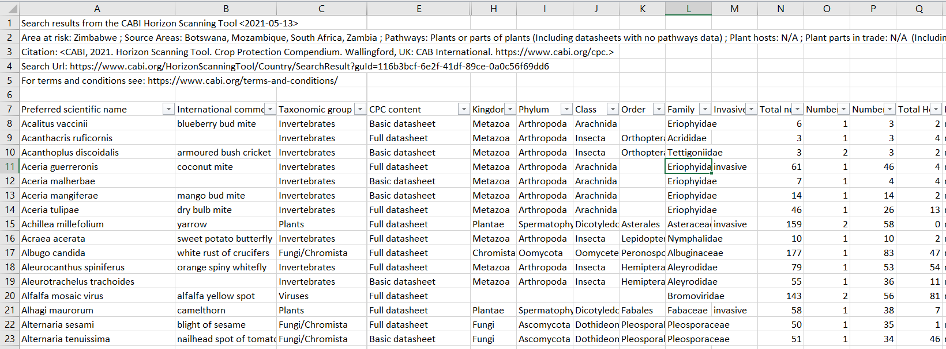
Help and feedback
Horizon scanning
The CABI tool
Conducting a scan
Scan results
Checking the scan results
Are species included that you know are already present in the area at risk?
Are species of concern missing from the results?
Can you quickly fill some of the data gaps for the filters you have selected?
Alternative information sources
Expert input
Notes:
The Horizon Scanning Tool is driven entirely by CPC and ISC data and should be checked against other sources. In particular, consider that recent introductions to source countries may not yet have been picked up by CABI and also that native species that are not particularly damaging in the area at risk are under-reported in the scientific literature that CABI researches.

Slide 14
Help and feedback
Horizon scanning
The CABI tool
Conducting a scan
Scan results
Additional data in the CSV to assist prioritization
Full datasheet in the CPC (for plant pests)
Invasive somewhere
Total distribution
Distribution in countries with matching climates
Distribution in neighbouring countries
Number of hosts
Notes:
The CSV files can be downloaded and opened in Excel. This is useful to compare the data with other sources, and to filter the results on the additional data fields:
Full datasheet in the CPC – CABI has commissioned full datasheets on the major pests
Invasive somewhere - recorded as an invasive species in the Invasive Species Compendium (ISC) i.e. these species are known invasive species
Number of distribution records of presence (Compendia countries and subnational areas) i.e. how widespread
Number of distribution records of presence in countries with matching climates
Number of distribution records of presence in neighbouring countries (with land borders)
Number of hosts recorded for that species
Also, taxonomic position to family level

Slide 15
Help and feedback
Horizon scanning
The CABI tool
Conducting a scan
Scan results
Tool Help page www.cabi.org/HorizonScanningTool/Home/Help
Training materials related to PRA
www.cabi.org/PRA-Tool/help
Queries and feedback to CABI
HST@cabi.org

