Slide 1
Improving biosecurity in Barbados and the OECS through the use of CABI Pest Risk Analysis (PRA) support tools in the Caribbean
Workshop, Coyaba Hotel, Grenada, 13-17 June 2022
Naitram (Bob) Ramnanan, Norbert Maczey, Suzy Wood
Title photo: Corin Pratt

Slide 2
Scope PRA workshop on Grenada
Training to use the recently developed CABI online tools for horizon scanning (HS) and Pest Risk Analysis (PRA)
allowing participants to independently conduct PRA by using the tools
setting PRAs in the context of existing biosecurity procedures of the individual countries participating
ask for feedback and suggestions for further improvement!
Notes:
triple image & content
main title - Arial26bold Grey-80%- max 2 lines
subtitle - 18bold Grey-80%- max 2 lines
body text black- may vary depending on heading between min=18pt, max=24pt
This slide is to describe the work of a project, product, department or team.
You may insert your own picture (Click icon to add picture). No line bordering picture.
Portfolio link http://portfolio:8090, enter your usual network username and password
TO ADD MORE SLIDES in Office2007 use the ‘New Slide’ dropdown on the ‘Home’ ribbon

Slide 3
Our tools to fight invasive pests and plant diseases
Monitoring
Regulation
Inspection
Risk Assessments
Awareness
Prevention
Eradication
Control

Slide 4
A full Pest Risk Analysis includes Risk assessment and Risk Management
Initiation (often through Horizon Scanning, pest alert etc.)
Pest categorization (taxonomy, distribution, hosts, etc.)
Risk assessment (Probability of introduction (pathways), establishment, spread and potential consequences)
Risk management (measures)
Decision
Risk?
Decision
Risks unacceptable
Notes:
The assessment in section A is in the form of a
binary decision tree, constructed from a sequence of questions based largely on decision points with two
alternative options. If the scheme leads to the conclusion that an organism has the necessary
characteristics of a quarantine pest, the pest is then evaluated in greater detail, in section B. From this
evaluation
, it should be possible to arrive at a conclusion concerning the level of 'pest risk' presented by
the pest. This conclusion can then be used in the pest risk management phase to determine whether the
risk is acceptable, and, to identify management options
.

Slide 5
Pest Risk Assessments – Invasive species/diseases
RISK
RISK
RISK
INTRODUCTION
ESTABLISHMENT
SPREAD

Slide 6
Pest Risk Assessments – Invasive species
RISK
RISK
RISK
INTRODUCTION
ESTABLISHMENT
SPREAD
REVIEW / CONSENSUS
Impact
Economy/Environment
MANAGEMENT
Recommendations/ACTION

Slide 7
Users of PRA
Different users may want to answer different questions
Researchers
Prioritise species before the start of a PRA (HST)
Which species we should focus?
Policy officers
Which species have higher impact?
Biosecurity officers
Evaluate / Recommend
Conservationists
What do we need to do? Do we need to do anything?
Is the species safe to import?
Can we release the biocontrol agent?

Slide 8
PRAs on islands need to differ to mainland regions
Different set of pathways (shipping, tourism, inter-island trade)
Often pressure by invasives particular large (long term isolation leading to high endemism rates; deliberate introductions (Ascension > 300 introduced plants v. ~15 native)
Possible better protected from future invasions (no connecting river system, rarely country boundaries dividing islands)
Islands often small; limited resources (money and skills, CBC costly)
High fluctuation of staff; limited impact of training
Limited access to information; Internet connectivity (limited, expensive)
Notes:
All variables are included in different models reviewed
Rain drops is an very important parameter for spreading from plant to plant

Slide 9
Other Risk Assessments/Analysis
 | Main Purpose | Taxa and habitat | Impacts considered
GB NAPRA | Full RA | All | Envir. and socio-economic
Harmonia+ (Belgium) | Full RA | All | Envir. and socio-economic
GABLIS (Austria/Germany) | Black list | All | Environmental
ISEIA Protocol (Belgium) | Black list | All | Environmental
Norwegian alien species impact assessment | Black list | All | Environmental
FISK and related (Copp and colleagues) | Invasion RA | Freshwater | Envir. and socio-economic
WRA (Pheloung et al 1999) | Invasion RA | Plants | Environmental
EPPO – Envir. Impact (Kenis et al 2012) | Part of full RA | Plant pests and plants | Environmental
EPPO - Prioritization (Brunel et al 2012) | Prioritization | Plants | Envir. and socio-economic
EFSA, Environmental risk assessment | Full RA | Plant pests and plants (later all) | Environmental
GISS (Nentwig and coll.) | Black list, prioritization | All | Envir. and socio-economic
EICAT-UICN (Blackburn et al. 2014) | Black list | All | Environmental
BINPAS (Olenin and coll.) | Prioritization, black list | Mainly aquatic | Environmental
Notes:
9

Slide 10
Overview existing PRA templates
EPPO ..\Project files 2019\PRA templates\NAPRA_EU_word_template_v1.1.doc
NNSS rapid ..\Project files 2019\PRA templates\NNSS RA_Crangonyx_pseudogracilis_(Northern_River_Amphipod).pdf
NNSS detailed..\Project files 2019\PRA templates\NNRA_word_template_v2.0.doc
FERA rapid ..\Project files 2019\PRA templates\japanusHyalinus.pdf
FERA detailed ..\Project files 2019\PRA templates\Tuta absoluta PRA.pdf
Falkland Darwin plus PRA for BC agents ..\Project files 2019\PRA templates\Annex 5 - PRA for Triarthria setipennis_07-11_2016.docx
Notes:
You may insert your own picture (Click icon to add picture). No line bordering picture.
Portfolio link http://portfolio:8090, enter your usual network username and password

Slide 11
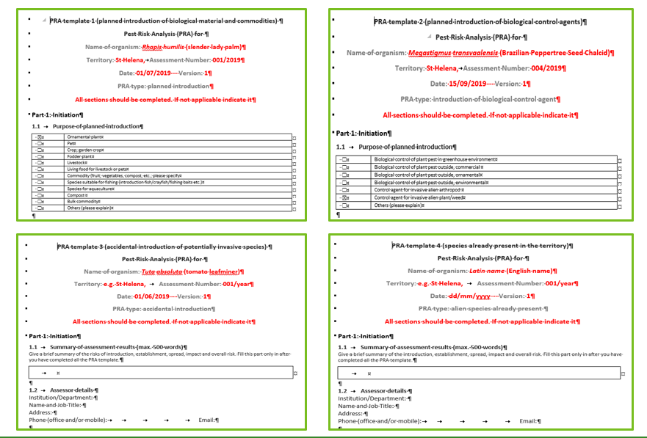

Slide 12
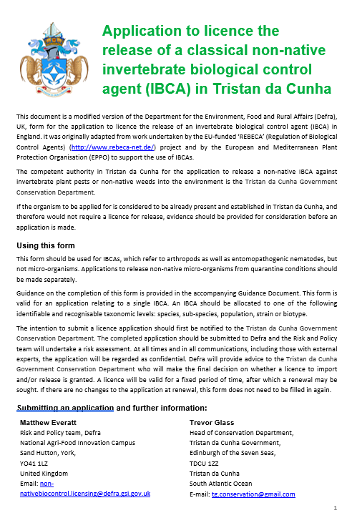
Risk assessment (RA)
During summer 2020 we conducted a RA for Microterys nietneri and its potential release on Tristan. The assessment showed that:
Biology and host range of the species are very well understood. M. nietneri develops oligophagously inside a relative wide range of Coccidae.
None of the three families have native/endemic representatives on Tristan.
M. nietneri is already present in South Africa, the only country with a direct transport link to Tristan, where it has previously been used for control of C. hesperidum in Citrus plantations.
There were no anticipated side or non-target effects predicted for a release on Tristan.
No additional host range testing was required for its use on Tristan.
As a result of the RA the import into Tristan, initially rearing and subsequent release were approved.
Title page of the RA for M. nietneri

Slide 13
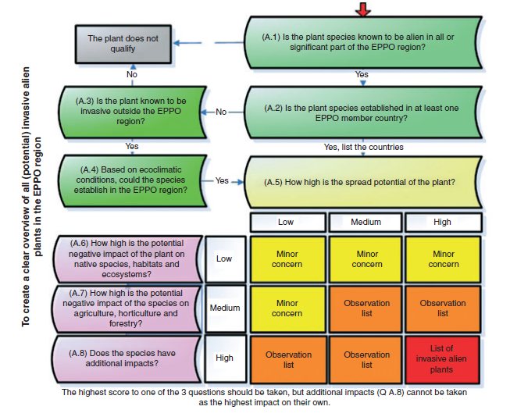
Various approaches to prioritise species for PRA in use
The EPPO prioritization process is designed:
to produce a list of invasive alien plants that are established or could potentially establish in the EPPO region, and
to determine which of these have the highest priority for an EPPO Pest Risk Analysis.
Notes:
All variables are included in different models reviewed
Rain drops is an very important parameter for spreading from plant to plant

Slide 14
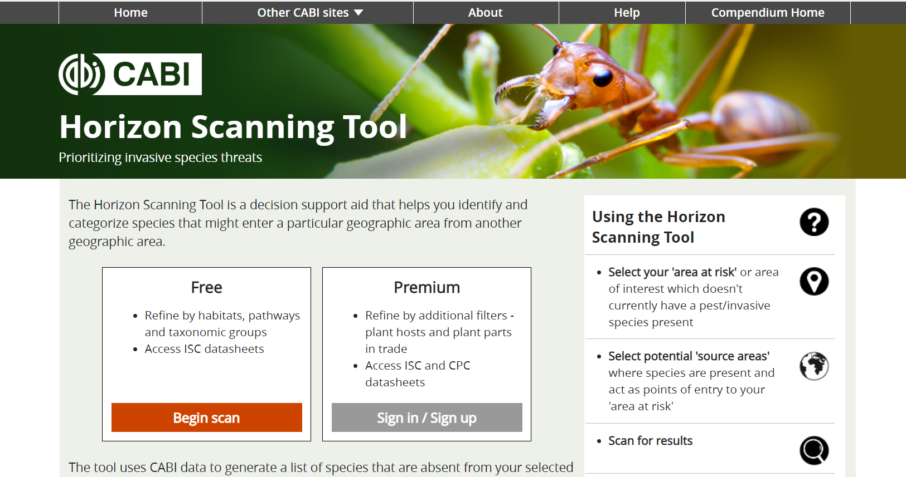

Slide 16
Our online approach
Easy access; help material, user friendly
Link to datasheets
Quick transfer of relevant information into PRA
Allows sharing and joint working
Future proof through updates

Slide 17
Whatever format is used
Everybody can conduct or use PRAs!
In an important tool in argumentation
Provide evidence to back up your argumentation
Compilation of references (peer-reviewed, recognised globally)

Slide 18
Procedures
PRAs part of wider biosecurity procedures
Workflow (factors which trigger/initiate a PRA for different types of PRAs)
Allow for new online tools to be integrated into process
Notes:
triple image & content
main title - Arial26bold Grey-80%- max 2 lines
subtitle - 18bold Grey-80%- max 2 lines
body text black- may vary depending on heading between min=18pt, max=24pt
This slide is to describe the work of a project, product, department or team.
You may insert your own picture (Click icon to add picture). No line bordering picture.
Portfolio link http://portfolio:8090, enter your usual network username and password
TO ADD MORE SLIDES in Office2007 use the ‘New Slide’ dropdown on the ‘Home’ ribbon

Slide 20
